Slide 2
”day of pentecost”
Acts 2:1-15**
October 22, 2023
San Angelo, TX

Slide 3
Acts 2:1
When the Day of Pentecost had fully come, they were all with one accord in one place.

Slide 5
Leviticus 23:1-2
And the Lord spoke to Moses, saying, ² “Speak to the children of Israel, and say to them: ‘The feasts of the Lord, which you shall proclaim to be holy convocations, these are My feasts.

Slide 6
Feasts According to Leviticus 23
1. Passover
2. Unleavened Bread
3. Firstfruits
4. Weeks/Harvest/Pentecost
5. Trumpets/Rosh Hashanah
6. Atonement/Yom Kippur
7. Tabernacles/Booths
SPRING
FALL

Slide 7
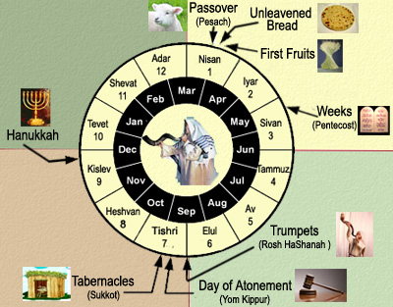

Slide 8
Colossians 2:16
So let no one judge you in food or in drink, or regarding a festival or a new moon or sabbaths, ¹⁷ which are a shadow of things to come, but the substance is of Christ.

Slide 9
SPRING FEASTS OF THE LORD
Passover
Unleavened Bread
Firstfruits
Weeks

Slide 10
Feast of Weeks/Harvest/Pentecost
Fifty days after Firstfruits, the Feast of Weeks was to occur, which was the final spring feast.
Counting Firstfruits as Day 1, and the Feast of Weeks as Day 50…. this feast would also always fall on the first day of the week.

Slide 11
New Testament Literal Reference
(Acts 2:1)
When the Day of Pentecost had fully come, they were all with one accord in one place.
Day of Pentecost and Feast of Weeks (Harvest) are one and the same! “Pentecost” is a Greek name that signifies fifty days.

Slide 12
Christ and the Feasts
Jesus was crucified on the Passover
Jesus was buried on the Feast of Unleavened Bread
Jesus was resurrected on the Feast of Firstfruits
The Holy Spirit descended and the church began on the Feast of Weeks (Day of Pentecost)

Slide 13
SPRING FEASTS OF THE LORD
Passover
Death
Unleavened Bread
Burial
Firstfruits
Resurrection
Holy Spirit Descends
Weeks

Slide 14
Acts 2:2
And suddenly there came a sound from heaven, as of a rushing mighty wind, and it filled the whole house where they were sitting.
Q: What was the purpose of the wind?
A: To draw attention from the crowd!

Slide 15
Acts 2:5-6a
And there were dwelling in Jerusalem Jews, devout men, from every nation under heaven. ⁶ And when this sound occurred, the multitude came together…

Slide 16
Acts 2:3
Then there appeared to them divided tongues, as of fire, and one sat upon each of them.
I really do not understand what this means, but I think it is important to understand that it was something visual that others could see.

Slide 17
Acts 2:4
And they were all filled with the Holy Spirit and began to speak with other tongues, as the Spirit gave them utterance.
I really do not understand how this could be, but I think it is important to understand that it was something auditory that others could hear.

Slide 18
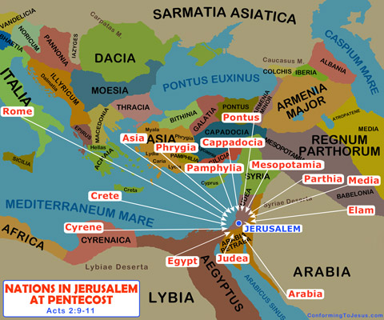
Acts 2:5
And there were dwelling in Jerusalem Jews, devout men, from every nation under heaven.

Slide 19
Tongues = Languages
This fact is made perfectly clear by 3 separate clarifying statements recorded by Luke, the author of Acts.
…because everyone heard them speak in his own language. (verse 6)
…we hear, each in our own language (verse 8)
…we hear them speaking in our own tongues (verse 11)

Slide 20
Glossolalia
ɡläsəˈlālēə,ˌɡlôsəˈlālēə/
the phenomenon of (apparently) speaking in an unknown language, especially in religious worship. It is practiced especially by Pentecostal and charismatic Christians.
The doctrine of glossolalia is not an old one in the history of the church - rather it is a newer innovation that is less than 200 years old.
-Charles A. Sullivan

Slide 21
Acts 2:6-7
And when this sound [of the mighty rushing wind] occurred, the multitude came together, and were confused, because everyone heard them speak in his own language. ⁷ Then they were all amazed and marveled, saying to one another, “Look, are not all these who speak Galileans?
(Matthew 26:73)
A little later some of the other bystanders came over to Peter and said, “You must be one of them; we can tell by your Galilean accent.” NLT

Slide 22
Acts 2:12-13
So they were all amazed and perplexed, saying to one another, “Whatever could this mean?”
¹³ Others mocking said, “They are full of new wine.”
We are introduced to two groups of spectators, one group that is amazed and perplexed and a second group that is mocking the Apostles.

Slide 23
Why would they think they were drunk?
I have always wondered how this could be considered a symptom of drunkenness. Finally, I might have a good explanation.
Think of the two groups:
Amazed and Perplexed
Mockers

Slide 24
Acts 2:14
But Peter, standing up with the eleven, raised his voice and said to them, “Men of Judea and all who dwell in Jerusalem, let this be known to you, and heed my words.
Think of the two groups:
Amazed and Perplexed (those who dwell in Jerusalem - visitors)
Mockers (men of Judea - locals)
LEON BROWN
Those that recognized the languages would be amazed and perplexed. Those that did not would consider these languages to be babbling and deserving of mockery!

Slide 25
Acts 2:15
For these are not drunk, as you suppose, since it is only the third hour of the day. (9 am)
And with this explanation, the Apostle Peter is prepared to give the most powerful sermon the world has ever heard!

Slide 26
Acts 2:14
But Peter, standing up with the eleven, raised his voice and said to them, “Men of Judea and all who dwell in Jerusalem, let this be known to you, and heed my words.
Whose words were more believable?
The Apostles
The Jewish leaders

