Slide 1
First Century
Facebook
August 20, 2017
San Angelo, TX

Slide 2
First Century Facebook
Basic Premise:
Human nature has not changed, only the means by which to express it.
Ecclesiastes 1:9
That which has been is what will be, That which is done is what will be done, And there is nothing new under the sun.

Slide 3
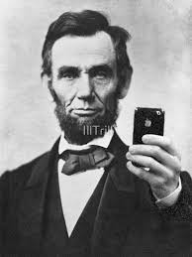
“Some people believe this was Photo Shopped.
Don’t be fooled…
Photo Shop was not invented in the 1800’s.

Slide 5
The Players
Facebook will be used as representative of all social media. (Instagram, SnapChat, etc)
Social media is also representative of all society.
First, let’s examine the danger of Facebook!

Slide 6
Interesting Statistics - 2017
Facebook Demographics – Omnicore Agency
Average FB user has 155 “friends”
87% of online users of age 18-29 are on FB
74% of college graduates are on FB
79% of online users of age 30-49 use FB
56% of online seniors aged 65+ are on FB

Slide 7
Interesting Statistics - 2017
Facebook Demographics – Omnicore Agency
48% of 18-34 year olds check FB when they first wake up
Every 20 minutes, 1 million links are shared, 20 million friend requests are sent, and 3 million messages are sent

Slide 8
Interesting Statistics - 2017
From Facebook
Average adult checks their phone 30 times per day
Average millennial checks their phone 150 times per day
From New York Times
The average person spends 50 minutes per day on FB (1/16 on wake time)

Slide 9
NYU Professor Adam Alter Irresistible: The Rise of Addictive Technology
“The minute you take a drug, drink alcohol, smoke a cigarette if those are your poison, when you get a like on social media, all of those experiences produce dopamine, which is a chemical that’s associate with pleasure.”

Slide 10
NYU Professor Adam Alter Irresistible: The Rise of Addictive Technology
“When someone likes an Instagram post…it’s a little bit like taking a drug. As far as your brain is concerned, it’s a very similar experience. Now the reason why is because it’s not guaranteed that you’re going to get likes on your posts. And it’s the unpredictability of that process that makes it so addictive.”

Slide 11
An attack on our youth
The Royal Society for Public Health and the Young Health Movement conducted a survey of almost 1,500 people of the ages of 15-24 concerning social media.
Four of the following five were deemed to have a negative effect on the well-being of those surveyed:
Facebook, SnapChat, Instagram, YouTube , Twitter

Slide 12
NYU Professor Adam Alter Irresistible: The Rise of Addictive Technology
“One of the problems with Instagram is that everyone presents the very best versions of their lives. What that means is, every time you look at someone’s feed, you’re getting only the very best aspects of their lives, which makes you feel like your life, in comparison with all its messiness, probably isn’t as good.”

Slide 13
Biblical Parallels
“Everyone is an expert”
“Reward the narcissist”
“Everybody’s highlight reel”

Slide 14
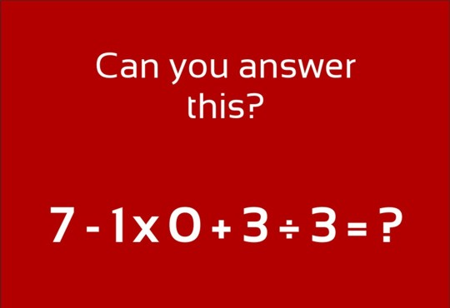
“Everyone is an expert”
All it takes to be an expert on Facebook is a keyboard or a smart phone.

Slide 15
James 3:1
My brethren, let not many of you become teachers, knowing that we shall receive a stricter judgment.
With greater influence comes greater responsibility!
Not everyone is qualified to be a teacher – whether in the church or in society in general.

Slide 16
Romans 2:21
You, therefore, who teach another, do you not teach yourself? You who preach that a man should not steal, do you steal?

Slide 17
2 Timothy 2:23
But avoid foolish and ignorant disputes, knowing that they generate strife.
Does this not sum up most of the comments on Facebook?

Slide 18
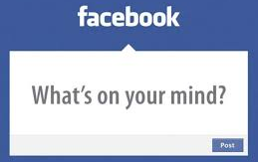
“Reward the narcissist”
To a certain degree, we are all narcissistic. However, Facebook gives a platform to reward the narcissist beyond what is acceptable.

Slide 19
Luke 20:45-47
Then, in the hearing of all the people, He said to His disciples, ⁴⁶ “Beware of the scribes, who desire to go around in long robes, love greetings in the marketplaces, the best seats in the synagogues, and the best places at feasts, ⁴⁷ who devour widows’ houses, and for a pretense make long prayers. These will receive greater condemnation.”
It was not the action condemned, but the purpose.

Slide 20
1 Timothy 2:9-10
…in like manner also, that the women adorn themselves in modest apparel, with propriety and moderation, not with braided hair or gold or pearls or costly clothing, ¹⁰ but, which is proper for women professing godliness, with good works.

Slide 21
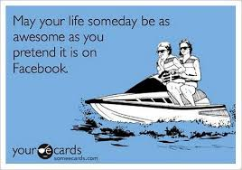
“Everybody’s highlight reel”
When it comes to Facebook, we only post what we want other people to see. Scrolling through the posts of our friends becomes a look at the best of our friend’s lives.

Slide 22
Matthew 23:25-28
“Woe to you, scribes and Pharisees, hypocrites! For you cleanse the outside of the cup and dish, but inside they are full of extortion and self-indulgence. ²⁶ Blind Pharisee, first cleanse the inside of the cup and dish, that the outside of them may be clean also.
Easton’s Bible Dictionary:
Hypocrite: one who puts on a mask and feigns himself to be what he is not

Slide 23
Matthew 23:25-28
²⁷ “Woe to you, scribes and Pharisees, hypocrites! For you are like whitewashed tombs which indeed appear beautiful outwardly, but inside are full of dead men’s bones and all uncleanness. ²⁸ Even so you also outwardly appear righteous to men, but inside you are full of hypocrisy and lawlessness.

Slide 24
Luke 11:39
Then the Lord said to him, “Now you Pharisees make the outside of the cup and dish clean, but your inward part is full of greed and wickedness.

Slide 25
2 Samuel 6:6-8
Yet the Bible is all about truth – good or bad.
And when they came to Nachon’s threshing floor, Uzzah put out his hand to the ark of God and took hold of it, for the oxen stumbled. ⁷ Then the anger of the Lord was aroused against Uzzah, and God struck him there for his error; and he died there by the ark of God. ⁸ And David became angry because of the Lord’s outbreak against Uzzah…

Slide 26
Hebrews 13:8
Jesus Christ is the same yesterday, today, and forever.
God is truth, and will not change. Why would we choose to place our confidence in man, who is constantly being deceptive?

Slide 27
Conclusion
Social media can be very damaging to people, especially our youth
As a society, we are wasting an inappropriate amount of time on FB
God never represents himself falsely, but man does on a daily basis on FB!
The Bible is truth – good or bad

Slide 28
Philippians 4:8
Finally, brethren, whatever things are true, whatever things are noble, whatever things are just, whatever things are pure, whatever things are lovely, whatever things are of good report, if there is any virtue and if there is anything praiseworthy—meditate on these things.
Harvard Business Review (4/10/17) – The more you use Facebook, the worse you feel

Slide 29
Romans 12:2
And do not be conformed to this world, but be transformed by the renewing of your mind, that you may prove what is that good and acceptable and perfect will of God.
It is difficult to transform our minds from this world if we spend 350 minutes engaged in the fictional, often harmful world of Facebook every week!

