Slide 2
Little Children, fathers, and young men 1 john 2:12-14
March 26, 2023
San Angelo, TX

Slide 3
1 John 2:12-14
I write to you, little children, Because your sins are forgiven you for His name’s sake. ¹³ I write to you, fathers, Because you have known Him who is from the beginning. I write to you, young men, Because you have overcome the wicked one. I write to you, little children, Because you have known the Father. ¹⁴ I have written to you, fathers, Because you have known Him who is from the beginning. I have written to you, young men, Because you are strong, and the word of God abides in you, And you have overcome the wicked one.

Slide 5
Microscope vs. Telescope
Often, we tend to teach as if viewing a passage through a “microscope”.
Ex. “What Must I Do To Be Saved?”
Lately, I have tried to put more effort into studying a passage through a “telescope”.
Ex. Look at the larger picture, including the style of writing or outline of an argument.

Slide 6
Poetry of the Scriptures
In your Bible, is 1 John 2:12-14 indented?
In mine it is, showing that the editors interpreted this passage as a form of poetry, or possibly even a song. This is often referred to as parallelism.
1a
1b
1c
2a
2b
2c

Slide 7
Parallelism
1a Little Children
1b Fathers
1c Young Men
2a Little Children
2b Fathers
2c Young Men

Slide 8
1 John 2:12-13a
I write to you, little children, Because your sins are forgiven you for His name’s sake.
¹³ I write to you, fathers, Because you have known Him who is from the beginning.
I write to you, young men, Because you have overcome the wicked one.

Slide 9
1 John 2:13b-14
I write to you, little children, Because you have known the Father.
¹⁴ I have written to you, fathers, Because you have known Him who is from the beginning.
I have written to you, young men, Because you are strong, and the word of God abides in you, And you have overcome the wicked one.

Slide 10
Who Does This Represent?
Actual children, fathers and young men
Different views of John’s audience as a whole
Different stages of spiritual maturity we all pass through
Different classes of John’s audience
It seems logical to conclude that John is addressing three classes of people:
New Christians, under the heading “children”
Older, mature Christians of long standing, as “fathers”
Young, yet mature, Christians as “young men”
Wayne Fussell, Contending for the Faith

Slide 11
A Quick Note to Congregational Teachers
When we teach an undivided assembly, it is important that we consider the different levels of our audience.
“Teaching” is about the transfer of knowledge from one mind to another, and different strategies should be used to attain this goal for everyone in the congregation!

Slide 12
Little Children
1a Because your sins are forgiven you for His name’s sake.
2a Because you have known the Father.

Slide 13
Acts 13:38
Therefore let it be known to you, brethren, that through this Man is preached to you the forgiveness of sins

Slide 14
1 John 3:1
Behold what manner of love the Father has bestowed on us, that we should be called children of God! Therefore the world does not know us, because it did not know Him.
Know God, Know Peace.
No God, No Peace

Slide 15
1 John 4:6-7
We are of God. He who knows God hears us; he who is not of God does not hear us. By this we know the spirit of truth and the spirit of error.
⁷ Beloved, let us love one another, for love is of God; and everyone who loves is born of God and knows God.

Slide 16
2 Thessalonians 1:7-8
…and to give you who are troubled rest with us when the Lord Jesus is revealed from heaven with His mighty angels, ⁸ in flaming fire taking vengeance on those who do not know God, and on those who do not obey the gospel of our Lord Jesus Christ.
Know God = Obey the Gospel of Jesus Christ

Slide 17
Titus 1:15-16
To the pure all things are pure, but to those who are defiled and unbelieving nothing is pure; but even their mind and conscience are defiled. ¹⁶ They profess to know God, but in works they deny Him, being abominable, disobedient, and disqualified for every good work.

Slide 18
Fathers
1b Because you have known Him who is from the beginning.
2b Because you have known Him who is from the beginning.

Slide 19
Known
The verb is in the perfect tense – “You came to know, and now know”
Guy N. Woods
I believe this term applies to “mothers” as well – these are the spiritual adults in the congregation that have progressed to a high spiritual level.

Slide 20
Ephesians 4:11-15
And He Himself gave some to be apostles, some prophets, some evangelists, and some pastors and teachers, ¹² for the equipping of the saints for the work of ministry, for the edifying of the body of Christ, ¹³ till we all come to the unity of the faith and of the knowledge of the Son of God, to a perfect man, to the measure of the stature of the fullness of Christ;
¹⁴ that we should no longer be children, tossed to and fro and carried about with every wind of doctrine, by the trickery of men, in the cunning craftiness of deceitful plotting, ¹⁵ but, speaking the truth in love, may grow up in all things into Him who is the head—Christ

Slide 21
John 1:1-3
In the beginning was the Word, and the Word was with God, and the Word was God. ² He was in the beginning with God. ³ All things were made through Him, and without Him nothing was made that was made.

Slide 22
Young Men
1c Because you have overcome the wicked one.
2c Because you are strong, and the word of God abides in you, And you have overcome the wicked one.

Slide 23
Still a Work in Progress
“Young men”, I believe, refers to strong Christians that have attained greater maturity than the “children” yet less than the “fathers”.
Finding the right mate
Building a home
Raising children
Becoming leaders of the church

Slide 24
Wicked One
(1 John 3:12)
…not as Cain who was of the wicked one and murdered his brother. And why did he murder him? Because his works were evil and his brother’s righteous.
(1 John 5:18-19)
We know that whoever is born of God does not sin; but he who has been born of God keeps himself, and the wicked one does not touch him.¹⁹ We know that we are of God, and the whole world lies under the sway of the wicked one.

Slide 25
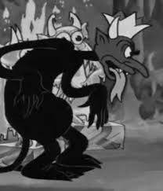
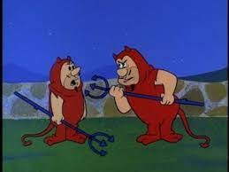
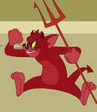
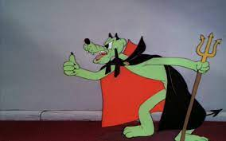
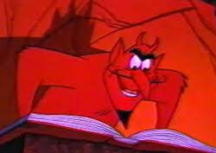
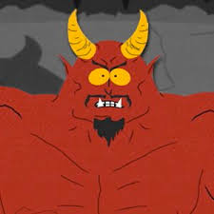
Don’t Make the Wicked One a Cartoon!

Slide 26
2 Timothy 2:1
You therefore, my son, be strong in the grace that is in Christ Jesus

Slide 27
Word of God Abides in You
(John 15:7)
If you abide in Me, and My words abide in you, you will ask what you desire, and it shall be done for you.
(Romans 10:8)
But what does it say? “The word is near you, in your mouth and in your heart”
(Colossians 3:16)
Let the word of Christ dwell in you richly

Slide 28
1 John 2:12-13a
I write to you, little children, Because your sins are forgiven you for His name’s sake.
¹³ I write to you, fathers, Because you have known Him who is from the beginning.
I write to you, young men, Because you have overcome the wicked one.

Slide 29
1 John 2:13b-14
I write to you, little children, Because you have known the Father.
¹⁴ I have written to you, fathers, Because you have known Him who is from the beginning.
I have written to you, young men, Because you are strong, and the word of God abides in you, And you have overcome the wicked one.

