Slide 2
“Meek”
July 24, 2019
San Angelo. TX

Slide 3
Matthew 5:5
Blessed are the meek, For they shall inherit the earth.

Slide 5
Definition of the word “Meek”
How would you define “meek”?
20th century Bible translator William Barclay said this was the “most untranslatable word in the New Testament”.

Slide 6
Galatians 5:22-23
But the fruit of the Spirit is love, joy, peace, longsuffering, gentleness, goodness, faith, ²³ Meekness, temperance: against such there is no law. (KJV)
”gentleness”. (Most translations)

Slide 7
What “Meek” is NOT!!
WEAK
TIMID
SHY
PUSHOVER
Unfortunately, this is what we typically think of when we hear this word!

Slide 8
2 Samuel 3:11-14
Then the Lord said to Samuel: “Behold, I will do something in Israel at which both ears of everyone who hears it will tingle. ¹² In that day I will perform against Eli all that I have spoken concerning his house, from beginning to end. ¹³ For I have told him that I will judge his house forever for the iniquity which he knows, because his sons made themselves vile, and he did not restrain them. ¹⁴ And therefore I have sworn to the house of Eli that the iniquity of Eli’s house shall not be atoned for by sacrifice or offering forever.”

Slide 9
Was Eli “Meek” or “Weak”?
Obviously Eli was not being commended for ignoring the sinful actions of his children. He was weak!! Being meek is a godly character trait that is very difficult to find.

Slide 10
Current Synonyms for Meek
From Reader’s Digest Oxford Complete Word Finder:
Timid Tame
Mild Docile
Bland Acquiescent
Unambitious Repressed
Retiring Spiritless
Weak Broken
WIMPY

Slide 11
Only 2 in Bible Called “Meek”
Moses (Numbers 12:3)
Jesus (2 Corinthians 10:1)
So which of those current words would you use to apply to Moses? Jesus? David? Elijah? Peter? Paul? Barnabas?
Without a doubt, the word has changed meaning from the original Greek.

Slide 12
Partial Definitions
Humility
Gentleness
Both terms are associated with meekness, but neither fully define its meaning.
Strong’s defines meekness as humility and mildness – close but not exact.

Slide 13
1 Peter 2:21-23
For to this you were called, because Christ also suffered for us, leaving us an example, that you should follow His steps:
²² “Who committed no sin, Nor was deceit found in His mouth”;
²³ who, when He was reviled, did not revile in return; when He suffered, He did not threaten, but committed Himself to Him who judges righteously

Slide 14
The Meekness of Jesus
Jesus felt the wrongs done against Him, but chose not to respond.
Jesus was thinking of us and did not allow His spirit to become vindictive.
Jesus committed Himself to God to allow the righteous judge to righteously settle things!

Slide 15
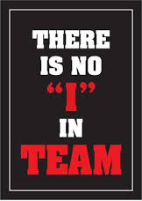
MEEK

Slide 16
The Complete Word Study Dictionary – New Testament
According to Aristotle, the word “prautes” means:
“the middle standing between two extremes, getting angry without reason, and not getting angry at all. It is getting angry at the right time, in the right measure, and for the right reason….it is a balance born in strength of character.”

Slide 17
Working Definition
Meek – Strength under control
Now do we understand why Barclay considered this the most untranslatable word in the New Testament?

Slide 18
New Testament Greek (Kione)
By the time of the writing of the New Testament, the word “praus” was translated as meek.
This word actually has it origin from the Greek military. Wild horses were found and brought into camp to be broken in. Over time, they were separated out. Only the best were considered “praus” and were trained for military service.

Slide 19
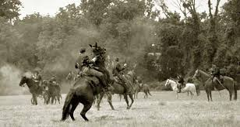

Slide 20
It has been said…
Greeks passed their secrets to the Romans.
Romans passed their secrets to the Moors.
Moors passed their secrets to the Spanish.
Spanish passed their secrets to the Austrians.
And the descendants of the Greek horses of war (praus) still live on today, known as the world famous….

Slide 21
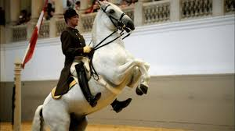
Lippizanner Stallions

Slide 22
Old Testament Origin – Psalm 37
“Meek” means to have power under control.
In short, it means to always do what is right regardless of the outcome.

