Slide 1
Seating Arrangements at The Last Supper

Slide 2
Traditional Seating Arrangements
By the time of Christ, Rabbinical traditions had set the seating arrangements for the traditional Passover feast.

Slide 3
Traditional Seating
Youngest
Host
Honored
Guest
Senior
Guest
Guest
Paschal Table
Dining Table
Least
Guest
Guest
Guest
Guest
Guest

Slide 4
Traditional Seating Arrangements
The youngest would sit to the right of the host, and they would have the honor of asking a scripted question of the host, something like “What makes this night different from all others?”
The host would then retell the history of the children of Israel

Slide 5
Traditional Seating Arrangements
The honored guest (greatest) would assume the seat directly to the left of the host.
The remaining seats would then be filled around the table by seniority in the group.
The guest with the least amount of seniority would assume the last seat at the table, directly across from the host.

Slide 6
Traditional Seating Arrangements
The seating arrangement appears to be on the minds of the disciples as the final Passover of the Lord is observed.

Slide 7
Luke 22:26-27
“…he who is greatest among you, let him be as the younger, and he who governs as he who serves. ²⁷ For who is greater, he who sits at the table, or he who serves? Is it not he who sits at the table? Yet I am among you as the One who serves.”

Slide 8
Mark 9:33-35
Then He came to Capernaum. And when He was in the house He asked them, “What was it you disputed among yourselves on the road?” ³⁴ But they kept silent, for on the road they had disputed among themselves who would be the greatest. ³⁵ And He sat down, called the twelve, and said to them, “If anyone desires to be first, he shall be last of all and servant of all.”

Slide 9
A closer look at the Scriptures
There are a few interesting passages in the Scriptures that can help to paint the picture in our minds.
Please do not think about one of the most famous paintings in the world, “The Last Supper”, by DaVinci. It does not appear that it is drawn according to the traditional seating arrangement.

Slide 10
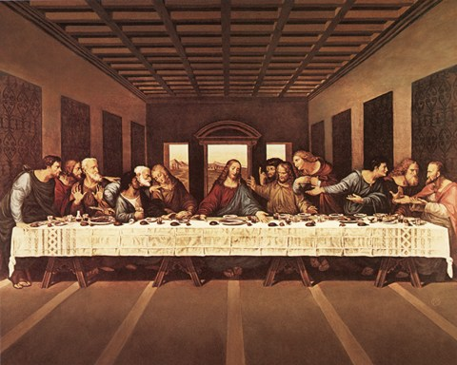
DaVinci’s Last Supper

Slide 11
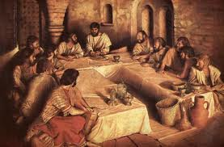
More Likely Seating Arrangement

Slide 12
John 13:23-25
Now there was leaning on Jesus’ bosom one of His disciples, whom Jesus loved. ²⁴ Simon Peter therefore motioned to him to ask who it was of whom He spoke.²⁵ Then, leaning back on Jesus’ breast, he said to Him, “Lord, who is it?”

Slide 13
Text Proof
If John was leaning on Jesus, he must have been next to him! Traditionally, guests would sit on pillows on the floor and then recline to the left.
If Peter was able to “motion’ to John, he must have been across the table from him!

Slide 14
Traditional Seating
John
Jesus
Honored
Guest
Senior
Guest
Guest
Paschal Table
Dining Table
Peter?
Peter?
Guest
Guest
Guest
Guest

Slide 15
John 13:26
Jesus answered, “It is he to whom I shall give a piece of bread when I have dipped it.” And having dipped the bread, He gave it to Judas Iscariot, the son of Simon.

Slide 16
Text Proof
Jesus handed the piece of bread to the other person beside him – Judas Iscariot!

Slide 17
Traditional Seating
John
Jesus
Judas Iscariot
Senior
Guest
Guest
Paschal Table
Dining Table
Peter?
Peter?
Guest
Guest
Guest
Guest

Slide 18
Galatians 6:3
For if anyone thinks himself to be something, when he is nothing, he deceives himself.

