Slide 1
The Case for the One Cup Communion
September 25, 2022
San Angelo, TX

Slide 2
6 QUESTIONS TO ANSWER
1) Is the word “cup” singular or plural?
2) Did the early church use one cup?
3) Who are the “Aquarians”?
4) What is the Holy Grail?
5) What is the “cup of blessing”?
6) Does it really make a difference?

Slide 4
BLANK CANVAS

Slide 5
Blank Canvas
Imagine for just a moment that you are hearing these words for the first time, with no preconceived notions.
No Luther. No Calvin. No da Vinci. No Lipscomb.
No Wade.
Listen to the words and re-create the scene in your mind!
What do you see?
A plurality of cups?

Slide 6
Matthew 26:26-29
And as they were eating, Jesus took bread, blessed and broke it, and gave it to the disciples and said, “Take, eat; this is My body.”
²⁷ Then He took the cup, and gave thanks, and gave it to them, saying, “Drink from it, all of you. ²⁸ For this is My blood of the new covenant, which is shed for many for the remission of sins.
²⁹ But I say to you, I will not drink of this fruit of the vine from now on until that day when I drink it new with you in My Father’s kingdom.”

Slide 7
Luke 22:20
Likewise He also took the cup after supper, saying, “This cup is the new covenant in My blood, which is shed for you.

Slide 8
Mark 14:23
Then He took the cup, and when He had given thanks He gave it to them, and they all drank from it.
And after taking the cup and giving thanks, he gave it to them, and they all drank from it. (New English Translation)
And when He had taken a cup and given thanks, He gave it to them, and they all drank from it. (New American Standard)
Also he took a cup of wine, made the b’rakhah, and gave it to them; and they all drank. (Complete Jewish Bible)

Slide 9
Even Wikipedia, the least valid of resources, declares:
The Synoptic Gospels refer to Jesus sharing a cup of wine with the Apostles, saying it was the covenant in his blood.

Slide 10
HISTORICAL

Slide 11
1 Corinthians 11:26-28
For as often as you eat this bread and drink this cup, you proclaim the Lord’s death till He comes.
²⁷ Therefore whoever eats this bread or drinks this cup of the Lord in an unworthy manner will be guilty of the body and blood of the Lord.
²⁸ But let a man examine himself, and so let him eat of the bread and drink of the cup.

Slide 12
Imitation is a Form of Flattery
St. Augustine (b354 – d430) in his "Catalogue of Heresies" says:
"The Aquarians are so called because in the cup of the Sacrament they offer water, not that which the whole Church offers."

Slide 13
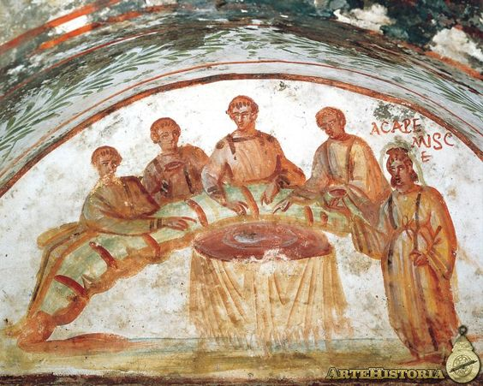
From the Catacombs of Rome

Slide 14
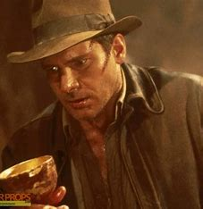
Holy Grail
FROM HISTORY.COM
The grail is most commonly identified as the cup that Jesus drank from at the Last Supper and that Joseph of Arimathea used to collect Jesus’s blood when he was crucified.
Throughout history, it was strongly believed that Jesus used one cup at the Lord’s Supper!
So how can this point be argued?

Slide 15
What is a cup?
Since the evidence is so overwhelming of the Lord’s use of one cup at the Last Supper, opponents of the one cup belief had to find another argument.
Typically, it involves a convoluted discussion of what a “cup” is.
Some will attempt to suggest that the “cup” refers only to its contents.
Again, I refer you to our blank canvas.
IS THAT WHAT YOU SAW?

Slide 16
Individual Cups
J.G. Thomas (1894)
C.E. Holt (1911)
G.C. Brewer (1915)
Ronny Wade – The Pattern for Communion, Let the Bible Speak

Slide 17
SYMBOLISM

Slide 18
1 Corinthians 10:16
The cup of blessing which we bless, is it not the communion of the blood of Christ? The bread which we break, is it not the communion of the body of Christ?

Slide 19
Gill’s Exposition
The Cup of Blessing
Meaning the cup of wine used in the Lord's supper…
This cup is so called in allusion to the cup of wine used at common meals, or at the Passover among the Jews, which they used to take and bless God with, and give him thanks for their mercies, and was commonly called , "the cup of blessing“.

Slide 20
Ephesians 4:4-6
There is one body and one Spirit, just as you were called in one hope of your calling; ⁵ one Lord, one faith, one baptism; ⁶ one God and Father of all, who is above all, and through all, and in you all.
I personally believe strongly in the symbolism of the one cup!

Slide 21
Does it make any difference?

Slide 22
6 QUESTIONS TO ANSWER
1) Is the word “cup” singular or plural?
2) Did the early church use one cup?
3) Who are the “Aquarians”?
4) What is the Holy Grail?
5) What is the “cup of blessing”?
6) Does it really make a difference?

Slide 23
Conclusion
It is common today to use “inference to the best explanation” to determine validity of an event.
In other words, what is the most logical explanation of the series of events?
“If it walks like a duck, quacks like a duck…”
“If it doesn’t make sense, it’s probably not true.”

Slide 24
Conclusion
What is the most logical explanation of the use of one cup at the Lord’s Supper?
Jesus used one cup at the Lord’s Supper, and that was the intended design.
This do, as often as you drink it, in remembrance of Me.”

