Slide 1
The Ed Principle Is this worth fighting over?
Principles to Live By
San Angelo, Tx
July 29, 2018

Slide 2
Joshua 22:12
And when the children of Israel heard of it, the whole congregation of the children of Israel gathered together at Shiloh to go to war against them.

Slide 4
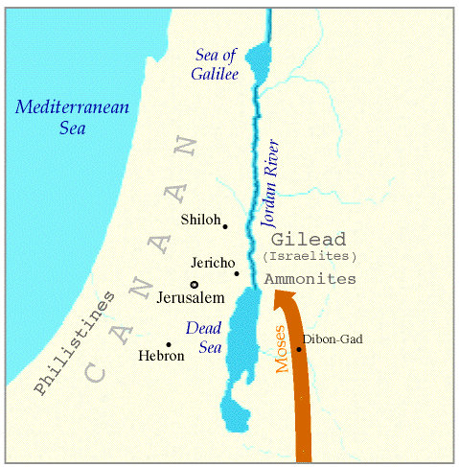

Slide 5
Numbers 32:5
Therefore they said, “If we have found favor in your sight, let this land be given to your servants as a possession. Do not take us over the Jordan.”
“they” - Tribes of Reuben and Gad
“your” - Moses
“this land” - Gilead, east of the Jordan

Slide 6
Joshua 22:1,4-5
Then Joshua called the Reubenites, the Gadites, and half the tribe of Manasseh,
⁴ And now the Lord your God has given rest to your brethren, as He promised them; now therefore, return and go to your tents and to the land of your possession, which Moses the servant of the Lord gave you on the other side of the Jordan.

Slide 7
Joshua 22:1,4-5
⁵ But take careful heed to do the commandment and the law which Moses the servant of the Lord commanded you, to love the Lord your God, to walk in all His ways, to keep His commandments, to hold fast to Him, and to serve Him with all your heart and with all your soul.”

Slide 8
WEST SIDE
EAST SIDE

Slide 9
Joshua 22:11
Now the children of Israel heard someone say, “Behold, the children of Reuben, the children of Gad, and half the tribe of Manasseh have built an altar on the frontier of the land of Canaan, in the region of the Jordan—on the children of Israel’s side.”

Slide 10
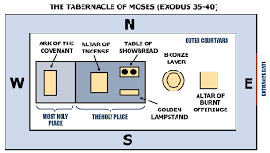
Tabernacle Plan

Slide 11
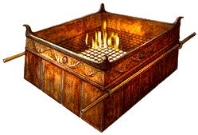
Artist Rendition of the Altar

Slide 12
Leviticus 17:8-9
“Also you shall say to them: ‘Whatever man of the house of Israel, or of the strangers who dwell among you, who offers a burnt offering or sacrifice, ⁹ and does not bring it to the door of the tabernacle of meeting, to offer it to the Lord, that man shall be cut off from among his people.

Slide 13
Joshua 22:12
And when the children of Israel heard of it, the whole congregation of the children of Israel gathered together at Shiloh to go to war against them.
“it” - Altar
“them” - East Siders

Slide 14
Phinehas and his Delegation
Phinehas the Priest
10 Rulers – one from each West Side tribe
‘What treachery is this that you have committed against the God of Israel, to turn away this day from following the Lord, in that you have built for yourselves an altar, that you might rebel this day against the Lord? (22:16)

Slide 15
Historical References
Peor (22:17)
Achan (22:20)
Peor – Numbers 25
The men committed harlotry with the Moabite women, on Balaam’s advice.
Achan – Joshua 7
Stole from the Battle of Ai

Slide 16
East Side Response
But in fact we have done it for fear, for a reason, saying, ‘In time to come your descendants may speak to our descendants, saying, “What have you to do with the Lord God of Israel? ²⁵ For the Lord has made the Jordan a border between you and us, you children of Reuben and children of Gad. You have no part in the Lord.” So your descendants would make our descendants cease fearing the Lord.’

Slide 17
Joshua 22:28-29
Therefore we said that it will be, when they say this to us or to our generations in time to come, that we may say, ‘Here is the replica of the altar of the Lord which our fathers made, though not for burnt offerings nor for sacrifices; but it is a witness between you and us.’

Slide 18
Liberty or Command?
The West Siders accepted the explanation of the East Siders, and civil war was avoided.
(Joshua 22: 31,33)
“This day we perceive that the Lord is among us, because you have not committed this treachery against the Lord. Now you have delivered the children of Israel out of the hand of the Lord.”
³³ So the thing pleased the children of Israel, and the children of Israel blessed God; they spoke no more of going against them in battle, to destroy the land where the children of Reuben and Gad dwelt.

Slide 19
Joshua 22
The children of Reuben and the children of Gad called the altar, Witness, “For it is a witness between us that the Lord is God.”
King James Version:
And the children of Reuben and the children of Gad called the altar Ed: for it shall be a witness between us that the Lord is God.

Slide 20
The Ed Principle
Be prepared to fight if necessary.

Slide 21
Revelation 3:15-16
Laodicea:
I know your works, that you are neither cold nor hot. I could wish you were cold or hot. ¹⁶ So then, because you are lukewarm, and neither cold nor hot, I will vomit you out of My mouth.
If we need to take a stand, then do it! It is too easy to remain on the sidelines and allow injustice to occur. Think Edwin Burke!

Slide 22
The Ed Principle
Be prepared to fight if necessary.
Not everyone needs to go.

Slide 23
Notable Quotes
“Everybody has the right to speak. However, you must earn the right to be heard.” – John Maxwell
“Usually the people who understand the least speak the loudest.” – Mayor Dwain Morrison

Slide 24
Biblical Conflict Plan
Any disagreement should be handled by the fewest number of people possible.
Therefore, if the disagreement cannot be handled by 2, then add a few .
Therefore, if the disagreement cannot be handled by a few, let the Church hear it too.

Slide 25
The Ed Principle
Be prepared to fight if necessary.
Not everyone needs to go.
Speak based on fact, not opinion.
Peor
Achan
Some years later, both Jeroboam Ahaz would be guilty of the same sin!

Slide 26
The Ed Principle
Be prepared to fight if necessary.
Not everyone needs to go.
Speak based on fact, not opinion.
Always allow an escape route.

Slide 27
The Escape Route
(Joshua 22:19)
Nevertheless, if the land of your possession is unclean, then cross over to the land of the possession of the Lord, where the Lord’s tabernacle stands, and take possession among us; but do not rebel against the Lord, nor rebel against us, by building yourselves an altar besides the altar of the Lord our God.

Slide 28
The Ed Principle
Be prepared to fight if necessary.
Not everyone needs to go.
Speak based on fact, not opinion.
Always allow an escape route.
Exercise discernment.

Slide 29
Definition: Discernment
Discernment is the ability to decide between truth and error, right and wrong.
Discernment is the process of making careful distinctions in our thinking about truth.
In short, THINK BIBLICALLY!

Slide 30
Discernment in the Scriptures
(1 Thessalonians 5:21-22)
Test all things; hold fast what is good. ²² Abstain from every form of evil.
(1 John 4:1)
Beloved, do not believe every spirit, but test the spirits, whether they are of God; because many false prophets have gone out into the world.

Slide 31
The Ed Principle
Be prepared to fight if necessary.
Not everyone needs to go.
Speak based on fact, not opinion.
Always allow an escape route.
Exercise discernment.
Accept the resolution.

Slide 32
Isaiah 43:18-19
“Do not remember the former things, Nor consider the things of old. ¹⁹ Behold, I will do a new thing, Now it shall spring forth; Shall you not know it?

Slide 33
Philippians 3:13-14
Brethren, I do not count myself to have apprehended; but one thing I do, forgetting those things which are behind and reaching forward to those things which are ahead, ¹⁴ I press toward the goal for the prize of the upward call of God in Christ Jesus.
Either accept the resolution or let it go!

Slide 34
THE ED PRINCIPLE
Conflict is expected in life, but there are steps we can follow to ensure it is handled correctly and with a Christian spirit.

Slide 35
Conclusion - The Ed Principle
Be prepared to fight if necessary.
Not everyone needs to go.
Speak based on fact, not opinion.
Always allow an escape route.
Exercise discernment.
Accept the resolution.

