Slide 1
The Fifth Kingdom of Daniel
Daniel 2:31-49

Slide 2
Four Things Necessary to a Kingdom
KING
SUBJECTS
TERRITORY
LAW

Slide 3
Daniel 2:44
And in the days of these kings the God of heaven will set up a kingdom which shall never be destroyed; and the kingdom shall not be left to other people; it shall break in pieces and consume all these kingdoms, and it shall stand forever.

Slide 4
Nebuchadnezzar’s Dream
His sleepless night (2:1)
Tell you the dream? (2:6)
Destroy the wise men of Babylon! (2:12)
Daniel receives the dream & interpretation (2:19)
Daniel blesses God (2:20-22)

Slide 5
Daniel 2:20-22
Daniel answered and said:
“Blessed be the name of God forever and ever, For wisdom and might are His. ²¹ And He changes the times and the seasons; He removes kings and raises up kings; He gives wisdom to the wise And knowledge to those who have understanding. ²² He reveals deep and secret things; He knows what is in the darkness, And light dwells with Him.

Slide 6
Hints to the interpretation
He removes/sets up kings
Psalm 75:7
But God is the Judge: He puts down one, And exalts another.

Slide 7
Hints to the interpretation
Times (periods of empires)
Seasons (phases of decline and fall)
Acts 1:7
And He said to them, “It is not for you to know times or seasons which the Father has put in His own authority.
Ecclesiastes 3:1
To everything there is a season, A time for every purpose under heaven:

Slide 8
Daniel 2:31-33
“You, O king, were watching; and behold, a great image! This great image, whose splendor was excellent, stood before you; and its form was awesome. This image’s head was of fine gold, its chest and arms of silver, its belly and thighs of bronze, ³³ its legs of iron, its feet partly of iron and partly of clay.

Slide 9
Daniel 2:34-35
You watched while a stone was cut out without hands, which struck the image on its feet of iron and clay, and broke them in pieces. ³⁵ Then the iron, the clay, the bronze, the silver, and the gold were crushed together, and became like chaff from the summer threshing floors; the wind carried them away so that no trace of them was found. And the stone that struck the image became a great mountain and filled the whole earth.

Slide 10
Nebuchadnezzar’s Vision
Head of fine gold (2:32)
Chest and arms of silver (2:32)
Belly and thighs of bronze (2:32)
Legs of iron (2:33)
Feet of iron and clay (2:33)
Stone cut without hands (2:34)

Slide 11
The Dream Explained
BABYLON

Slide 12
Daniel 2:37-38
You, O king, are a king of kings. For the God of heaven has given you a kingdom, power, strength, and glory; ³⁸ and wherever the children of men dwell, or the beasts of the field and the birds of the heaven, He has given them into your hand, and has made you ruler over them all—you are this head of gold.

Slide 13
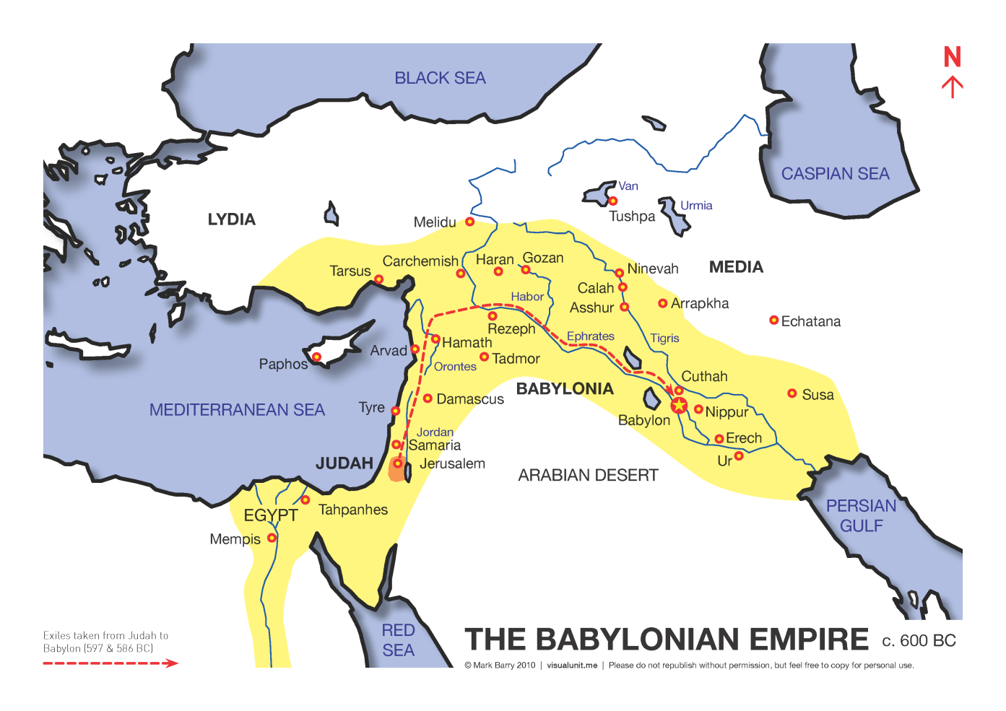
BABYLON
The Jews fell captive to the Babylonian Empire about 605 B.C.

Slide 14
The Dream Explained
BABYLON
MEDO-PERSIANS

Slide 15
Daniel 2:39
But after you shall arise another kingdom inferior to yours;

Slide 16
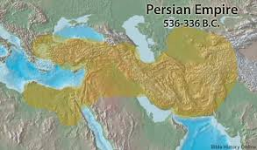
MEDO-PERSIANS
Formed under Cyrus the Great in 536 B.C.

Slide 17
The Dream Explained
BABYLON
MEDO-PERSIANS
GREECE

Slide 18
Daniel 2:39
…then another, a third kingdom of bronze, which shall rule over all the earth.

Slide 19
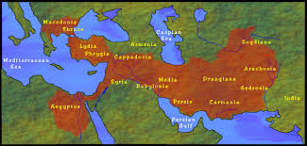
GREECE
Formed under Alexander the Great in 336 B.C.

Slide 20
Later Vision
Daniel 8:20-21
The ram which you saw, having the two horns—they are the kings of Media and Persia. ²¹ And the male goat is the kingdom of Greece.
These visions were specifically designed to explain the current and future world kingdoms in the time of Daniel. We must also follow this interpretation!

Slide 21
The Dream Explained
BABYLON
MEDO-PERSIANS
GREECE
ROME

Slide 22
Daniel 2:40
And the fourth kingdom shall be as strong as iron, inasmuch as iron breaks in pieces and shatters everything; and like iron that crushes, that kingdom will break in pieces and crush all the others.

Slide 23
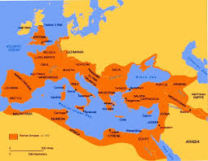
ROME
Rome came into power about 146 B.C. and Greece became a Roman province

Slide 24
Daniel 2:41-42
Whereas you saw the feet and toes, partly of potter’s clay and partly of iron, the kingdom shall be divided; yet the strength of the iron shall be in it, just as you saw the iron mixed with ceramic clay. ⁴² And as the toes of the feet were partly of iron and partly of clay, so the kingdom shall be partly strong and partly fragile.

Slide 25
Problems with the Roman Empire
Strongest military the world had ever seen
Conquered peoples were allowed to maintain their own cultures, as long as they paid their taxes
This caused strife throughout the Empire, as it remained constantly in a state of division

Slide 26
Daniel 2:44
And in the days of these kings the God of heaven will set up a kingdom which shall never be destroyed; and the kingdom shall not be left to other people; it shall break in pieces and consume all these kingdoms, and it shall stand forever.

Slide 27
In the days of these kings…..
This takes us to the days of the New Testament (circa AD 30)
Notice that John the Baptist and Christ spoke of the kingdom in the future tense
It would be during the time of this kingdom that God would set up a kingdom that would last forever

Slide 28
Matthew 3:1-2
In those days John the Baptist came preaching in the wilderness of Judea, ² and saying, “Repent, for the kingdom of heaven is at hand!”

Slide 29
Luke 9:27
But I [Jesus] tell you truly, there are some standing here who shall not taste death till they see the kingdom of God.”

Slide 30
After the day of Pentecost…
The kingdom was then spoken of in the present tense
1 Thessalonians 2:12
… that you would walk worthy of God who calls you into His own kingdom and glory.
Revelation 1:9
… I, John, both your brother and companion in the tribulation and kingdom and patience of Jesus Christ…

Slide 31
5th KINGDOM
The fifth and final kingdom of Daniel is none other than the Lord’s Church.
It will never be destroyed.
It will stand forever.
It will consume all nations.

Slide 32
Daniel 2:45
Inasmuch as you saw that the stone was cut out of the mountain without hands, and that it broke in pieces the iron, the bronze, the clay, the silver, and the gold—the great God has made known to the king what will come to pass after this.

Slide 33
Matthew 21:42-44
Jesus said to them, “Have you never read in the Scriptures:
‘The stone which the builders rejected Has become the chief cornerstone. This was the Lord’s doing, And it is marvelous in our eyes’?
⁴³ “Therefore I say to you, the kingdom of God will be taken from you and given to a nation bearing the fruits of it. ⁴⁴ And whoever falls on this stone will be broken; but on whomever it falls, it will grind him to powder.”

Slide 34
Four Things Necessary to a Kingdom
KING
SUBJECTS
TERRITORY
LAW
1 Timothy 6:15

Slide 35
1 Timothy 6:15
… He who is the blessed and only Potentate, the King of kings and Lord of lords

Slide 36
Four Things Necessary to a Kingdom
KING
SUBJECTS
TERRITORY
LAW
1 Timothy 6:15
Colossians 1:13

Slide 37
Colossians 1:13
He has delivered us from the power of darkness and conveyed us into the kingdom of the Son of His love…

Slide 38
Four Things Necessary to a Kingdom
KING
SUBJECTS
TERRITORY
LAW
1 Timothy 6:15
Colossians 1:13
Matthew 28:18-20

Slide 39
Matthew 28:18-20
And Jesus came and spoke to them, saying, “All authority has been given to Me in heaven and on earth. ¹⁹ Go therefore and make disciples of all the nations, baptizing them in the name of the Father and of the Son and of the Holy Spirit, ²⁰ teaching them to observe all things that I have commanded you; and lo, I am with you always, even to the end of the age.” Amen

Slide 40
Four Things Necessary to a Kingdom
KING
SUBJECTS
TERRITORY
LAW
1 Timothy 6:15
Colossians 1:13
Matthew 28:18-20
Romans 8:2

Slide 41
Romans 8:2
For the law of the Spirit of life in Christ Jesus has made me free from the law of sin and death.

Slide 42
Four Things Necessary to a Kingdom
KING
SUBJECTS
TERRITORY
LAW
1 Timothy 6:15
Colossians 1:13
Matthew 28:18-20
Romans 8:2

