Slide 2
The order of melchizedek (Hebrews 5:6)
December 26, 2021
San Angelo, TX

Slide 3
Hebrews 5:6
“You are a priest forever According to the order of Melchizedek”

Slide 5
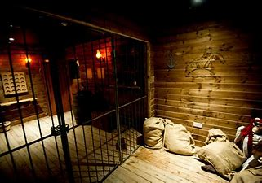
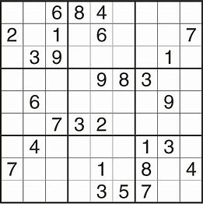
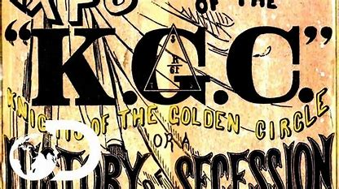

Slide 6
Melchizedek in the Scriptures
Genesis 14
Psalm 110
Hebrews 5,6,7
These are the only Biblical references to Melchizedek. I think people today are too concerned with the man Melchizedek and miss the bigger picture of the order of Melchizedek. That will be our focus this morning.

Slide 7
Genesis 14:8-12
And the king of Sodom, the king of Gomorrah, the king of Admah, the king of Zeboiim, and the king of Bela (that is, Zoar) went out and joined together in battle in the Valley of Siddim ⁹ against Chedorlaomer king of Elam…four kings against five. ¹⁰ …and the kings of Sodom and Gomorrah fled…¹¹ Then they took all the goods of Sodom and Gomorrah, and all their provisions, and went their way. ¹² They also took Lot...

Slide 8
Genesis 14:14, 16
Now when Abram heard that his brother was taken captive, he armed his three hundred and eighteen trained servants who were born in his own house, and went in pursuit…
¹⁶ So he brought back all the goods, and also brought back his brother Lot and his goods, as well as the women and the people.

Slide 9
Genesis 14:18-20
Then Melchizedek king of Salem brought out bread and wine; he was the priest of God Most High. ¹⁹ And he blessed him and said:
“Blessed be Abram of God Most High, Possessor of heaven and earth; ²⁰ And blessed be God Most High, Who has delivered your enemies into your hand.”
And he [Abram] gave him a tithe of all.

Slide 10
Melchizedek the Man
Who was this mysterious man?
Theophany of Jesus
Shem, son of Noah
Simply Melchizedek!
I think people today are too concerned with the man Melchizedek and miss the bigger picture of the order of Melchizedek.

Slide 11
I. King + Priest = order of Melchizedek
Then Melchizedek king of Salem brought out bread and wine; he was the priest of God Most High.

Slide 12
Lots of Water Under the Bridge
Abram → Abraham
Abraham beget Isaac
Isaac beget Jacob
Jacob beget 12 sons
Journey into Egypt
400 years of slavery in Egypt
Exodus
Law delivered at Mt. Sinai
Establishment of the Aaronic priesthood thru the tribe of Levi

Slide 13
I. King + Priest = order of Melchizedek
II. Pre-dated the order of Aaron by over 600 years

Slide 14
Approximate Melchizedek Timeline
2084 BC Melchizedek meets Abram
1446 BC Law of Moses established
1010 BC David becomes King
So after this initial clue is given, the Scriptures are silent in regard to Melchizedek for about 1,000 years until David out of the blue makes reference to this incident!

Slide 15
Psalm 110: 1- 4
The Lord [Jehovah] said to my Lord [Adonay], “Sit at My right hand, Till I make Your enemies Your footstool.” ² The Lord shall send the rod of Your strength out of Zion. Rule in the midst of Your enemies!
³ Your people shall be volunteers In the day of Your power; In the beauties of holiness, from the womb of the morning, You have the dew of Your youth. ⁴ The Lord has sworn And will not relent, “You are a priest forever According to the order of Melchizedek.”

Slide 16
Understand the Lyrics?
Who is Melchizedek?
$\frac{3}{5630}$ = 0.000533 = 0.0533%

Slide 17
Psalm 110:1
The Lord [Jehovah] said to my Lord [Adonay], “Sit at My right hand, Till I make Your enemies Your footstool.”
Who does “my Lord [Adonay]” refer to?

Slide 18
Matthew 22:41- 45
While the Pharisees were gathered together, Jesus asked them, ⁴² saying, “What do you think about the Christ? Whose Son is He?” They said to Him, “The Son of David.”
⁴³ He said to them, “How then does David in the Spirit call Him ‘Lord,’ saying:
⁴⁴ ‘The Lord said to my Lord, “Sit at My right hand, Till I make Your enemies Your footstool” ’?
⁴⁵ If David then calls Him ‘Lord,’ how is He his Son?” ⁴⁶ And no one was able to answer Him a word, nor from that day on did anyone dare question Him anymore.

Slide 19
Approximate Melchizedek Timeline
2084 BC Melchizedek meets Abram
1446 BC Law of Moses established
1010 BC David becomes King
AD 32 Jesus quoted Psalm 110 as Messianic
AD 68 Writing of the Book of Hebrews
David writes Psalm 110, and it takes another 1,000 years or so for Jesus to relate the Messiah and the order of Melchizedek.

Slide 20
Hebrews 5:6-11
As He also says in another place:
“You are a priest forever According to the order of Melchizedek”;
⁷ who, in the days of His flesh, when He had offered up prayers and supplications, with vehement cries and tears to Him who was able to save Him from death, and was heard because of His godly fear, ⁸ though He was a Son, yet He learned obedience by the things which He suffered.

Slide 21
Hebrews 5:6-11
⁹ And having been perfected, He became the author of eternal salvation to all who obey Him, ¹⁰ called by God as High Priest “according to the order of Melchizedek,” ¹¹ of whom we have much to say, and hard to explain, since you have become dull of hearing.
Not the order of Aaron, but rather the order of Melchizedek!

Slide 22
Hebrews 6:19-20
This hope we have as an anchor of the soul, both sure and steadfast, and which enters the Presence behind the veil, ²⁰ where the forerunner has entered for us, even Jesus, having become High Priest forever according to the order of Melchizedek.

Slide 23
Hebrews 7:1-3
For this Melchizedek, king of Salem, priest of the Most High God, who met Abraham returning from the slaughter of the kings and blessed him, ² to whom also Abraham gave a tenth part of all, first being translated “king of righteousness,” and then also king of Salem, meaning “king of peace,” ³ without father, without mother, without genealogy, having neither beginning of days nor end of life, but made like the Son of God, remains a priest continually.

Slide 24
I. King + Priest = order of Melchizedek
II. Pre-dated the order of Aaron by over 600 years
III. Continual priesthood

Slide 25
Hebrews 7:11
Therefore, if perfection were through the Levitical [Aaronic] priesthood (for under it the people received the law), what further need was there that another priest should rise according to the order of Melchizedek, and not be called according to the order of Aaron?

Slide 26
Hebrews 7:13-14
For He of whom these things are spoken belongs to another tribe, from which no man has officiated at the altar.
¹⁴ For it is evident that our Lord arose from Judah, of which tribe Moses spoke nothing concerning priesthood.
A major stumbling block has now been explained! How could Jesus, of the tribe of Judah, become the High Priest of the nation of Israel?

Slide 27
Hebrews 7:15-17
And it is yet far more evident if, in the likeness of Melchizedek, there arises another priest ¹⁶ who has come, not according to the law of a fleshly commandment, but according to the power of an endless life. ¹⁷ For He testifies:
“You are a priest forever According to the order of Melchizedek.”

Slide 28
I. King + Priest = order of Melchizedek
II. Pre-dated the order of Aaron by over 600 years
III. Continual priesthood
IV. Judah vs Levi Issue

Slide 29
Hebrews 7:21-24
“The Lord has sworn And will not relent, ‘You are a priest forever According to the order of Melchizedek’ ”,
²² by so much more Jesus has become a surety of a better covenant.
²³ Also there were many priests, because they were prevented by death from continuing. ²⁴ But He, because He continues forever, has an unchangeable priesthood.

Slide 30
IMPRESSIVE!
A mind-blowing clue that took over 2,100 years to fully explain the Prophet-Priest roles of the Messiah!
Yet right there it was in black and white, hiding in plain sight for anyone to see – yet few actually saw it!
Is there any doubt that God has an eternal plan for salvation?
God had already solved a potential problem some 600 years before it even happened!!!

Slide 31
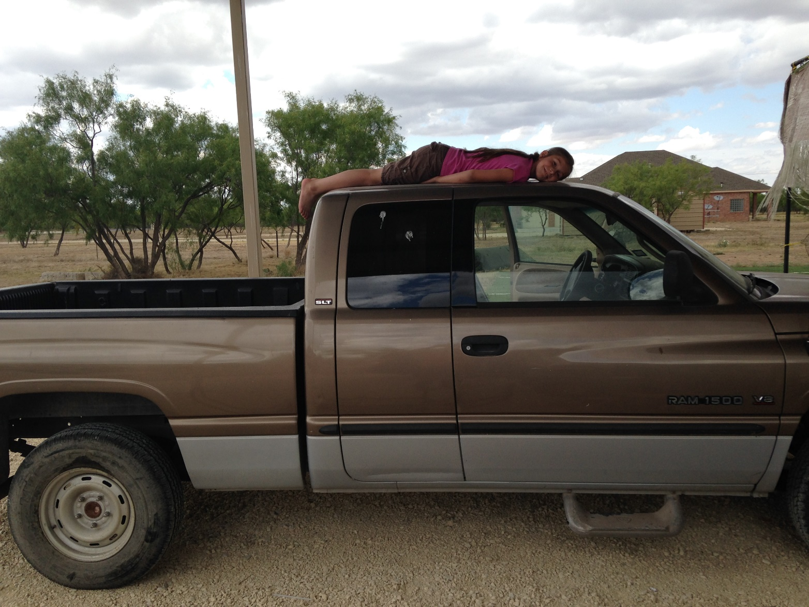
Fixing Brownie

