Slide 1
Things the Apostle Paul and I are Thankful for
1 Thessalonians 5:18

Slide 2
1 Thessalonians 5:18
…in everything give thanks; for this is the will of God in Christ Jesus for you.

Slide 4
Church Family
I am thankful for each and every person who assembles to worship here.
I appreciate that everyone is treated with love and respect.

Slide 5
Why are people so mean?

Slide 6
Hosea 4:1-2
Hear the word of the Lord, You children of Israel, For the Lord brings a charge against the inhabitants of the land:
“There is no truth or mercy Or knowledge of God in the land.

Slide 7
Hosea 4:1-2
² By swearing and lying, Killing and stealing and committing adultery, They break all restraint, With bloodshed upon bloodshed.

Slide 8
Perilous Times
2 Timothy 3:1-5
May these traits never been known among the Lord’s Church!

Slide 9
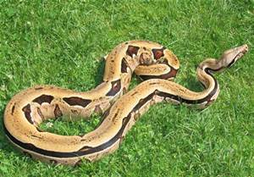
An Analogy

Slide 10
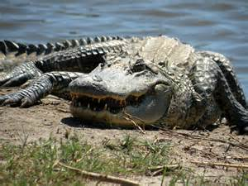
An Analogy

Slide 11
An Analogy
What happens when a boa constrictor meets up with an alligator?
Sometimes, the boa wins.
Sometimes, the alligator wins.
Sometimes, ….

Slide 12
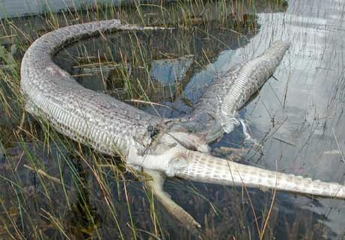
An Analogy

Slide 13
Galatians 5:14-15
For all the law is fulfilled in one word, even in this: “You shall love your neighbor as yourself.” ¹⁵ But if you bite and devour one another, beware lest you be consumed by one another!

Slide 14
Church Family
Let us never forget to treat our church family with love and respect.
Let us never cease to do good for one another.

Slide 15
Word of God
I am thankful for the amount of respect shown for God’s word by our congregation.
I am thankful for the means we have to study it.
Study more!!!

Slide 16
Hosea 4:6
My people are destroyed for lack of knowledge. Because you have rejected knowledge, I also will reject you from being priest for Me; Because you have forgotten the law of your God, I also will forget your children.

Slide 17
The Process
I am thankful that we are part of a growth process.
We will make mistakes along the way, but never stop growing.

Slide 18
1 Thessalonians 5:18
…in everything give thanks; for this is the will of God in Christ Jesus for you.
It takes a mature Christian to be thankful for trials and tribulations!

Slide 19
"I wish you Enough....“
I wish you enough sun to keep your attitude bright.
I wish you enough rain to appreciate the sun more.
I wish you enough happiness to keep your spirit alive.
I wish you enough pain so that the smallest joys in life appear much bigger.

Slide 20
"I wish you Enough....“
I wish you enough gain to satisfy your wanting.
I wish you enough loss to appreciate all that you possess.
I wish enough "Hello's" to get you through the final "Good-bye..

Slide 21
1 Peter 2:2
…as newborn babes, desire the pure milk of the word, that you may grow thereby
Everyone is expected to grow! That is how the church is sustained over the years!

Slide 22
Apostle Paul’s Turn

Slide 23
1 Thessalonians 1:2-3
We give thanks to God always for you all, making mention of you in our prayers, ³ remembering without ceasing your work of faith, labor of love, and patience of hope in our Lord Jesus Christ in the sight of our God and Father

Slide 24
Apostle Paul is Thankful for…
Work of Faith

Slide 25
John 6:28-29
Then they said to Him, “What shall we do, that we may work the works of God?”
²⁹ Jesus answered and said to them, “This is the work of God, that you believe in Him whom He sent.”

Slide 26
Apostle Paul is Thankful for…
Work of Faith
Labor of Love

Slide 27
Hebrews 6:10
For God is not unjust to forget your work and labor of love which you have shown toward His name, in that you have ministered to the saints, and do minister.

Slide 28
Apostle Paul is Thankful for…
Work of Faith
Labor of Love
Patience of Hope

Slide 29
Romans 5:3-5
And not only that, but we also glory in tribulations, knowing that tribulation produces perseverance; ⁴ and perseverance, character; and character, hope. ⁵ Now hope does not disappoint, because the love of God has been poured out in our hearts by the Holy Spirit who was given to us.

Slide 30
Conclusion
We have much to be thankful for!

