Slide 2
”UNNAMED HEROES”
May 5, 2019
San Angelo, TX

Slide 3
Where Everybody Knows Your Name
We all appreciate recognition!
Unfortunately, many do not feel as though their contributions are worth much unless they get recognition.
Football – Offense or Defense?

Slide 5
2 Kings 5:1
Now Naaman, commander of the army of the king of Syria, was a great and honorable man in the eyes of his master, because by him the Lord had given victory to Syria.

Slide 6
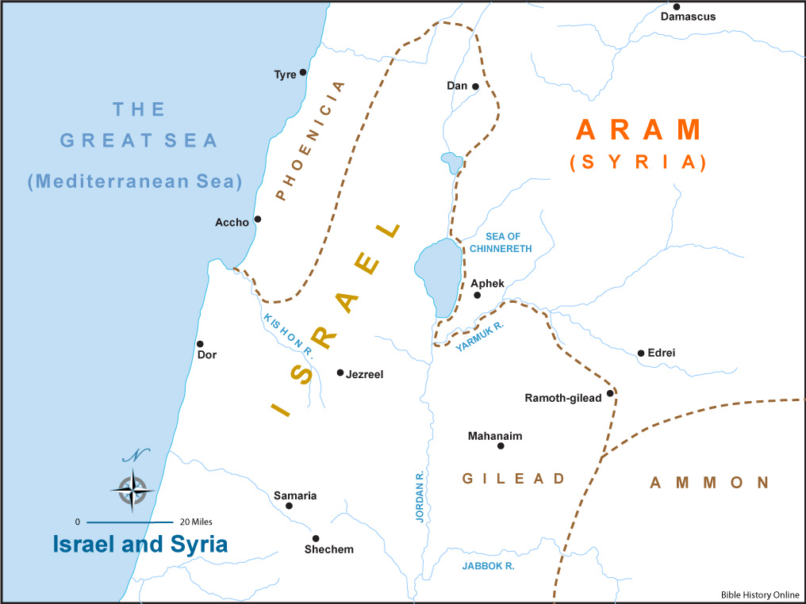
ARAM (SYRIA)

Slide 7
2 Kings 5:1
He was also a mighty man of valor, but a leper.
Leviticus 13 – Leprosy Laws

Slide 8
2 Samuel 3:28-29
Afterward, when David heard it, he said, “My kingdom and I are guiltless before the Lord forever of the blood of Abner the son of Ner. ²⁹ Let it rest on the head of Joab and on all his father’s house; and let there never fail to be in the house of Joab one who has a discharge or is a leper, who leans on a staff or falls by the sword, or who lacks bread.”
Leprosy was a curse on mankind!

Slide 9
Luke 17:12-18
Then as He entered a certain village, there met Him ten men who were lepers, who stood afar off. ¹³ And they lifted up their voices and said, “Jesus, Master, have mercy on us!”
¹⁴ So when He saw them, He said to them, “Go, show yourselves to the priests.” And so it was that as they went, they were cleansed.

Slide 10
Luke 17:12-18
¹⁵ And one of them, when he saw that he was healed, returned, and with a loud voice glorified God, ¹⁶ and fell down on his face at His feet, giving Him thanks. And he was a Samaritan.
¹⁷ So Jesus answered and said, “Were there not ten cleansed? But where are the nine? ¹⁸ Were there not any found who returned to give glory to God except this foreigner?”

Slide 11
Unnamed Hero #1
The young girl
“If only my master were with the prophet who is in Samaria! For he would heal him of his leprosy.” (2 Kings 5:3)
Q: Why was she willing to offer this information to her enemies?
A: Bloom where you are planted!

Slide 12
2 Kings 5:5
Then the king of Syria said, “Go now, and I will send a letter to the king of Israel.”
This quickly became a matter of great importance between two rival nations.
As a gift, Naaman took:
1) silver 2) gold 3) clothes.
Our first world problem of “having nothing to wear” is insulting to those who used clothes as currency!

Slide 13
The King’s Letter
Now be advised, when this letter comes to you, that I have sent Naaman my servant to you, that you may heal him of his leprosy.
The King of Israel saw this as a trap by the Syrian King, and “tore his clothes”.

Slide 14
2 Kings 5:8
So it was, when Elisha the man of God heard that the king of Israel had torn his clothes, that he sent to the king, saying, “Why have you torn your clothes? Please let him come to me, and he shall know that there is a prophet in Israel.”
Create opportunities to spread the Word of God!
IGNORE----REACT----ANTICIPATE----CREATE

Slide 15
2 Kings 5:9
Then Naaman went with his horses and chariot, and he stood at the door of Elisha’s house.

Slide 16
Unnamed Hero #2
A Messenger
“Go and wash in the Jordan seven times, and your flesh shall be restored to you, and you shall be clean.” (2 Kings 5:10)
These words were not delivered to Naaman by Elisha, but rather by an unnamed messenger.
Is tremendous show of disrespect made Naaman furious! “Do you know who I am?”

Slide 17
2 Kings 5:11
But Naaman became furious, and went away and said, “Indeed, I said to myself, ‘He will surely come out to me, and stand and call on the name of the Lord his God, and wave his hand over the place, and heal the leprosy.’
Sure, he hated the rivers of Israel and the seemingly ridiculous solution offered but make no mistake Naaman was most upset by the disrespect shown by Elisha.
So he turned and went away in a rage. (v.12)

Slide 18
Unnamed Heroes #3
His Servants
“My father, if the prophet had told you to do something great, would you not have done it? How much more then, when he says to you, ‘Wash, and be clean’?” (2 Kings 5:13)
The servants offered wise counsel – their opinion was based on common sense not arrogance.

Slide 19
Wisdom of Proverbs
(Proverbs 13:20)
He who walks with wise men will be wise, But the companion of fools will be destroyed.
(Proverbs 22:24-25)
Make no friendship with an angry man, And with a furious man do not go, ²⁵ Lest you learn his ways And set a snare for your soul.

Slide 20
2 Kings 5:14
So he went down and dipped seven times in the Jordan, according to the saying of the man of God; and his flesh was restored like the flesh of a little child, and he was clean.
Fortunately for Naaman, he was willing to heed the advice of some Unnamed Heroes.

Slide 21
2 Kings 5:15
And he returned to the man of God, he and all his aides, and came and stood before him; and he said, “Indeed, now I know that there is no God in all the earth, except in Israel…

Slide 22
Lessons from the Unnamed Heroes
1) Godly advice can come from unlikely sources
2) It’s not “who” says it, but “what” they say
3) We all need common sense confidants

Slide 23
Luke 4:27
From the sermon at the synagogue in Nazareth:
And many lepers were in Israel in the time of Elisha the prophet, and none of them was cleansed except Naaman the Syrian.”

