Slide 1
For a Nominal Fee (John 2:13-17)
December 27, 2020
San Angelo, Tx

Slide 2
John 2:13-17
Now the Passover of the Jews was at hand, and Jesus went up to Jerusalem. ¹⁴ And He found in the temple those who sold oxen and sheep and doves, and the money changers doing business. ¹⁵ When He had made a whip of cords, He drove them all out of the temple, with the sheep and the oxen, and poured out the changers’ money and overturned the tables. ¹⁶ And He said to those who sold doves, “Take these things away! Do not make My Father’s house a house of merchandise!” ¹⁷ Then His disciples remembered that it was written, “Zeal for Your house has eaten Me up.”

Slide 3
Questions
How many times did Jesus “cleanse” the Temple?
Where in the Temple did this action actually occur?
Was there a need for the animals during Passover?
Why were money changers necessary?
Did doves represent peace?
Was the system corrupt?
What did the disciples think of this?

Slide 4
Cleanse the Temple – Once or Twice?
John 2
Beginning of His ministry
Matthew 21, Mark 11, Luke 19
End of His ministry

Slide 5
Luke 19:45-48
Then He went into the temple and began to drive out those who bought and sold in it, ⁴⁶ saying to them, “It is written, ‘My house is a house of prayer,’ but you have made it a ‘den of thieves.’ ”
⁴⁷ And He was teaching daily in the temple. But the chief priests, the scribes, and the leaders of the people sought to destroy Him, ⁴⁸ and were unable to do anything; for all the people were very attentive to hear Him.

Slide 6
Twice
Even though the situations are very similar, it appears as they were two separate events separated by 3 years.
Hints:
Timing words of John 2
No whip mentioned in Matthew, Mark, Luke
Immediate confrontation in John 2

Slide 7
Where in the Temple?
The word “Temple” can be used in both a general or a specific sense. In this case, it is likely that John was using the word Temple to reference the entire 30 acre complex.

Slide 9
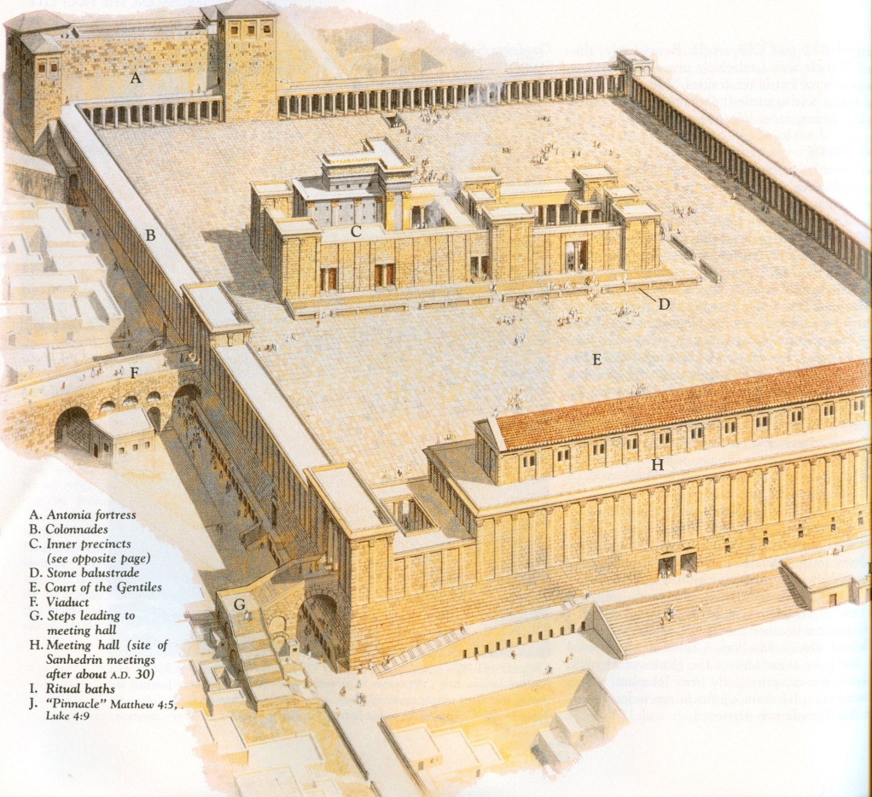
Court of the Gentiles
The activity of the day was no doubt found in the outer court of the complex, known as the Court of the Gentiles.
Anyone – Jew or Gentile – was allowed in this area.

Slide 10
A Later Passover…
“…Parthians and Medes and Elamites, those dwelling in Mesopotamia, Judea and Cappadocia, Pontus and Asia, ¹⁰ Phrygia and Pamphylia, Egypt and the parts of Libya adjoining Cyrene, visitors from Rome, both Jews and proselytes, ¹¹ Cretans and Arabs—we hear them speaking in our own tongues the wonderful works of God.” (Acts 2:9-11)

Slide 12
Need for Animals
(Deuteronomy 17:1)
“You shall not sacrifice to the Lord your God a bull or sheep which has any blemish or defect, for that is an abomination to the Lord your God.

Slide 13
Enter the “Mumcheh”, or Expert
The pilgrim then had two options:
Bring their own animals and have them inspected by a priest-appointed mumcheh
Buy a “Previously Certified” animal from a priest-approved vendor at the Temple….for a nominal fee, of course

Slide 14
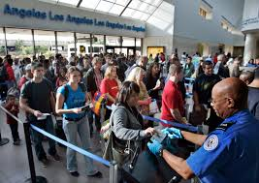
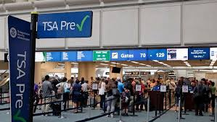
Similar to Today

Slide 15
Why Moneychangers?
(Exodus 30:13)
This is what everyone among those who are numbered shall give: half a shekel according to the shekel of the sanctuary. The half-shekel shall be an offering to the Lord.
(Nehemiah 10:32)
Also we made ordinances for ourselves, to exact from ourselves yearly one-third of a shekel for the service of the house of our God:
ANY OTHER TYPE OF COINAGE HAD TO BE EXCHANGED FOR SHEKELS FOR THE TEMPLE TAX!

Slide 16
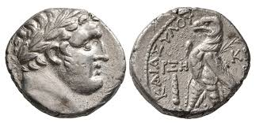
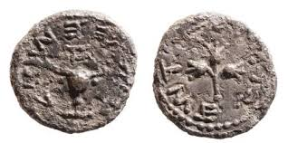
Purpose of the Money Changers
Starting the 15th of Adar (one month before Passover) an early exchange period in the outlying areas to convert coins to shekels
Shulchanim (money changers)
After the 25th of Adar, Shulchanim moved to the Temple, and set up in the Court of the Gentiles
A moah (type of coin) was charged, representing the qolbon, or nominal fee for the exchange
FROM EDERSHEIM

Slide 17
For a Nominal Fee
The qolbon was typically about one-quarter to half of the amount of tax itself.
If you needed change from the Shulchanim, you had to pay a double qolbon.
Add that to the fee paid to the mumcheh for the sacrificial animal, and it was quite a racket!
Exodus 22:25

Slide 18
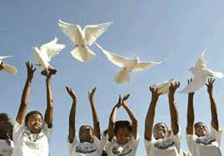
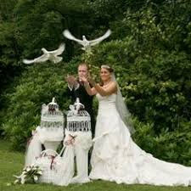
What Do Doves Represent?
In our culture, the releasing of doves represents everlasting love and peace. What about during the time of Jesus?

Slide 19
Leviticus 14: 21-22
“But if he is poor and cannot afford it, then he shall take one male lamb as a trespass offering… ²² and two turtledoves or two young pigeons, such as he is able to afford
This was also the case for destitute mothers who could not afford a lamb to sacrifice after childbirth.

Slide 20
Doves Represented Poverty
The poor should NEVER be taken advantage of!
(Deuteronomy 15: 11)
For the poor will never cease from the land; therefore I command you, saying, ‘You shall open your hand wide to your brother, to your poor and your needy, in your land.’
“Two Turtledoves and a Partridge in a Pear Tree”
Luke 2:24

Slide 21
Was the System Corrupt?
The system certainly had opportunity to be corrupted, and it appears from the reaction of Jesus that he thought it was!!
Either bought from the priests, or dealt with a priest-appointed inspector
Everything purchased had a stout brokerage fee
It was a monopoly for the priests
Took advantage of the poor and faithful
Gamaliel’s Son

Slide 22
John 2:13-17
Now the Passover of the Jews was at hand, and Jesus went up to Jerusalem. ¹⁴ And He found in the temple those who sold oxen and sheep and doves, and the money changers doing business. ¹⁵ When He had made a whip of cords, He drove them all out of the temple, with the sheep and the oxen, and poured out the changers’ money and overturned the tables. ¹⁶ And He said to those who sold doves, “Take these things away! Do not make My Father’s house a house of merchandise!”

Slide 23
Remember the Scriptures
(John 2:17)
Then His disciples remembered that it was written, “Zeal for Your house has eaten Me up.”
(Psalm 69:9)
Because zeal for Your house has eaten me up, And the reproaches of those who reproach You have fallen on me.

Slide 24
Questions
How many times did Jesus “cleanse” the Temple?
Where in the Temple did this action actually occur?
Was there a need for the animals during Passover?
Did doves represent peace?
Why were money changers necessary?
Was the system corrupt?
What did the disciples think of this?

