Slide 2
Great is Diana of the Ephesians!
July 30, 2023
San Angelo, TX

Slide 3
Acts 19:28
Now when they heard this, they were full of wrath and cried out, saying, “Great is Diana of the Ephesians!”

Slide 5
Diana or Artemis?
Artemis, in Greek religion, the goddess of wild animals, the hunt, and vegetation and of chastity and childbirth; she was identified by the Romans with Diana. Artemis was the daughter of Zeus and Leto and the twin sister of Apollo.
-Wikipedia

Slide 6
Acts 19:23-24
And about that time there arose a great commotion about the Way. 24 For a certain man named Demetrius, a silversmith, who made silver shrines of Diana, brought no small profit to the craftsmen.

Slide 7
From Archeological Musesum of Ephesus

Slide 8
Acts 19:25-26
He called them together with the workers of similar occupation, and said: “Men, you know that we have our prosperity by this trade. Moreover you see and hear that not only at Ephesus, but throughout almost all Asia, this Paul has persuaded and turned away many people, saying that they are not gods which are made with hands.

Slide 9
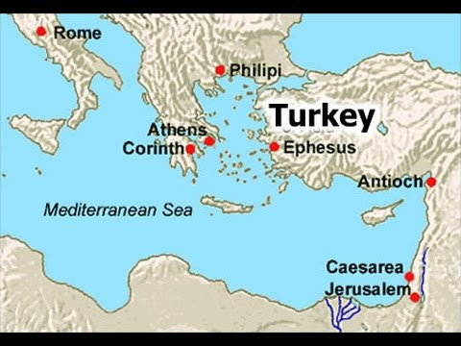

Slide 10
Acts 19:27
So not only is this trade of ours in danger of falling into disrepute, but also the temple of the great goddess Diana may be despised and her magnificence destroyed, whom all Asia and the world worship.”

Slide 11
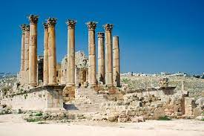
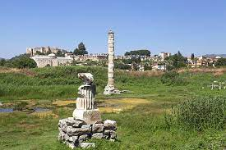
Temple of Diana Now

Slide 12
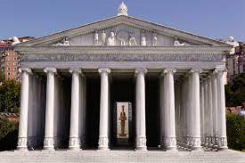
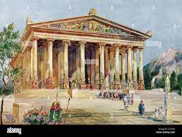
Temple of Diana Then

Slide 13
Acts 19:28-31
Now when they heard …..
Losing $$$$$
Civic pride of Ephesus

Slide 14
Acts 19:28-31
Now when they heard this, they were full of wrath and cried out, saying, “Great is Diana of the Ephesians!”

Slide 15
“Great is Diana of the Ephesians!”

Slide 16
Acts 19:29-31
So the whole city was filled with confusion, and rushed into the theater with one accord, having seized Gaius and Aristarchus, Macedonians, Paul’s travel companions. 30 And when Paul wanted to go in to the people, the disciples would not allow him. 31 Then some of the officials of Asia, who were his friends, sent to him pleading that he would not venture into the theater.

Slide 17
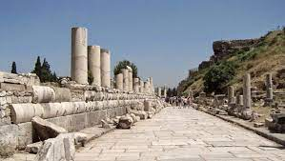
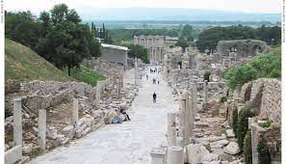
Ephesus Main Street (Curetes)

Slide 18
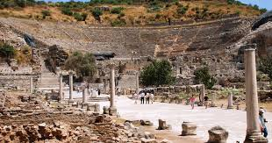
Road to the Theater

Slide 19
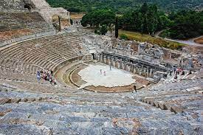
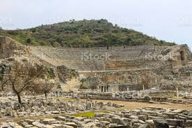
Ephesus Theater

Slide 20
Acts 19:32-33
Some therefore cried one thing and some another, for the assembly was confused, and most of them did not know why they had come together. 33 And they drew Alexander out of the multitude, the Jews putting him forward. And Alexander motioned with his hand, and wanted to make his defense to the people. 34 But when they found out that he was a Jew, all with one voice cried out for about two hours, “Great is Diana of the Ephesians!”

Slide 21
Q: What did the Jews want Alexander to say?
A: I suppose his job was to convince the Ephesians that Paul had NOTHING to do with the Jews!

Slide 22
Acts 19:34
But when they found out that he was a Jew, all with one voice cried out for about two hours, “Great is Diana of the Ephesians!”

Slide 23
“Great is Diana of the Ephesians!”

Slide 24
Acts 19:35-37
And when the city clerk had quieted the crowd, he said: “Men of Ephesus, what man is there who does not know that the city of the Ephesians is temple guardian of the great goddess Diana, and of the image which fell down from Zeus? 36 Therefore, since these things cannot be denied, you ought to be quiet and do nothing rashly. 37 For you have brought these men here who are neither robbers of temples nor blasphemers of your goddess.

Slide 25
Acts 19:38-41
Therefore, if Demetrius and his fellow craftsmen have a case against anyone, the courts are open and there are proconsuls. Let them bring charges against one another. 39 But if you have any other inquiry to make, it shall be determined in the lawful assembly. 40 For we are in danger of being called in question for today’s uproar, there being no reason which we may give to account for this disorderly gathering.” 41 And when he had said these things, he dismissed the assembly.

Slide 26
Lessons from the Ephesus Riot
Determine the motivation of a potential leader.
Remember the ignorance of the mob mentality.
Appreciate the faithfulness of Paul and his companions.

Slide 27
Acts 20:1
After the uproar had ceased, Paul called the disciples to himself, embraced them, and departed to go to Macedonia.

