Slide 1
Problems with NOT Having Bible Classes

Slide 2
Hosea 4:6
My people are destroyed for lack of knowledge: because thou hast rejected knowledge, I will also reject thee, that thou shalt be no priest to me: seeing thou hast forgotten the law of thy God, I will also forget thy children.

Slide 4
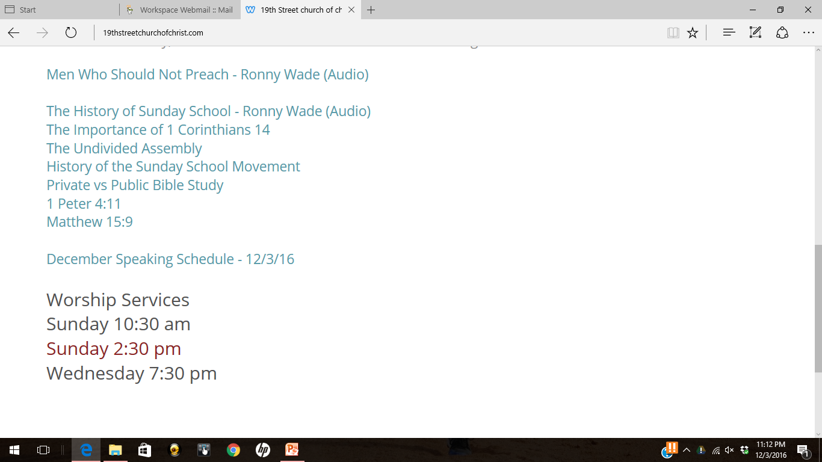
19thstreetchurchofchrist.com

Slide 5
Conclusion of the Matter
The New Testament is silent on the matter of Sunday School and Bible Classes.
In and of itself, that is reason enough for us not to participate in this movement.
We should respect the “Silence of the Scriptures”

Slide 6
Other Issues With Bible Classes and Sunday School
Teaching lacks oversight
Unqualified teachers are allowed to teach
Blurring of public and private teaching
Conflict with 1 Corinthians 14
Lacks scriptural authority

Slide 7
Problems with NOT Having Bible Classes
This might sound like a strange title for a sermon, but I believe this is important for anyone who wants to worship God in spirit and truth.

Slide 8
1. Study of the Word is reduced.
Unintended Consequence – in an attempt to stand for the truth, we have neglected a great opportunity for study of His Word.
While we have no right to change God’s plan , we do have an obligation to execute God’s plan.
“No Bible Classes” = More Dallas Cowboy Football!

Slide 9
Berea or Thessalonica?
Acts 17:11
These [brethren of Berea] were more fair-minded than those in Thessalonica, in that they received the word with all readiness, and searched the Scriptures daily to find out whether these things were so.

Slide 10
If we don’t have classes…
… do we study on our own?
… do we teach our children on our own?
… do we study with others on our own?
We should never use our opposition to Bible Classes and Sunday School as an excuse to avoid studying the Word.

Slide 11
Bible Study

Slide 12
Typical Objection to Study
“The Bible is so very complicated and I don’t understand it!”
Let me give some advice on personal Bible study.

Slide 13
Suggested Resources
While the Bible itself is all we ever need, the following resources are helpful in study:
Concordance (For example Strong’s or Cruden’s)
Expository Dictionary (Vine’s)
Topical Bible Dictionary
Bible Dictionary
Parallel Versions
Commentaries (be careful)

Slide 14
Luke 8:12
From the Parable of the Sower:
Those by the wayside are the ones who hear; then the devil comes and takes away the word out of their hearts, lest they should believe and be saved.

Slide 15
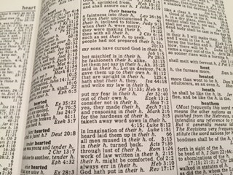
Cruden’s Concordance

Slide 16
biblehub.com

Slide 17
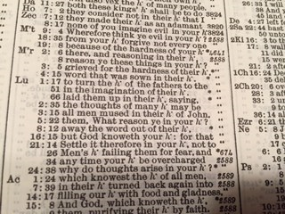
Strong’s Concordance

Slide 18
Strong’s Greek Lexicon

Slide 19
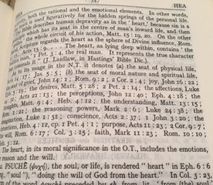
Vine’s Expository Dictionary

Slide 20
Personal Responsibility
It is the responsibility of every Christian to spend much time in study of God’s Word.
The lack of Bible classes should never be an excuse to study less!
This is especially true for children who might not understand everything taught from the pulpit.

Slide 21
2. Small Group Study is Neglected.
Unintended Consequence – we tend to avoid small group studies completely, and lose a great teaching tool.
Splitting up the congregation into smaller groups for public worship would not be scriptural (1 Corinthians 14:23)

Slide 22
Acts 20:20 – Types of Teaching
PUBLIC
PRIVATE
SMALL GROUP
SMALL GROUP
UNSCRIPTURAL
SCRIPTURAL
Our stance against Bible classes and Sunday School should not prevent us from having private small group studies!

Slide 23
Titus 2:2-7
“…that the older men be sober, reverent, temperate, sound in faith, in love, in patience; ³ the older women likewise, that they be reverent in behavior, not slanderers, not given to much wine, teachers of good things— ⁴ that they admonish the young women to love their husbands, to love their children, ⁵ to be discreet, chaste, homemakers, good, obedient to their own husbands, that the word of God may not be blasphemed.

Slide 24
Titus 2:2-7
⁶ Likewise, exhort the young men to be sober-minded, ⁷ in all things showing yourself to be a pattern of good works”
When does this instruction take place?

Slide 25
Bible Study is Imperative!
As Christians, we should spend much time in study of God’s Word. Let us not overlook the importance of studying one with another in a private setting – including small groups!

Slide 26
3. Some Members Fail to Grow.
James 3:1.
“My brethren, let not many of you become teachers, knowing that we shall receive a stricter judgment.”
Unintended Consequence – with each congregation only having a few teachers, others find few opportunities to teach.

Slide 27
Taking Part in the Teaching
Many men are not willing to be congregational teachers, but still desire to be active.
Ronny Wade: “Men Who Should Not Preach.”

Slide 28
Additional Opportunities
However, in churches that employ Sunday School and Bible Classes, they have additional (albeit unscriptural) opportunities to lead, teach, and grow.
All of this could be done through private Bible study! Yet sadly, some members fail to grow and ignore this opportunity.

Slide 29
The 3-Hour Club
In a noble attempt oppose innovation, it appears that we often reduce the Church to a weekly 3-Hour Club.
Opposing Sunday School and Bible Classes should not be a reason to reduce fellowship!
We choose not to have Bible Classes because we believe them to be unscriptural – not as an incentive to “get done” earlier!

Slide 30
Romans 12:10
Be kindly affectionate to one another with brotherly love, in honor giving preference to one another

Slide 31
CONCLUSION
Problems with NOT Having Bible Classes:
1. Study of the Word is reduced.
2. Small Group Study is Neglected.
3. Some Members Fail to Grow.
We must avoid these problems, or we give others reason to doubt God’s design!

Slide 32
CONCLUSION
Let us be an example of how following God’s plan will lead to a strong, healthy and vibrant Church.

