Slide 2
Q&A: IS the Euphrates river important?
December 27, 2023
San Angelo, TX

Slide 3
The Euphrates River is mentioned throughout the Bible.
Genesis ←→ Revelation

Slide 4
Genesis 2:10,14
Now a river went out of Eden to water the garden, and from there it parted and became four riverheads… The fourth river is the Euphrates.

Slide 5
The World That Then Was
Remember, these rivers (as well as the entire Earth) were dramatically changed after the flood of Noah’s day.
(2 Peter 3:6)
Whereby the world that then was, being overflowed with water, perished

Slide 6
Euphrates Today

Slide 7
The Middle East vs Texas!

Slide 8
Genesis 15:18
On the same day the Lord made a covenant with Abram, saying:
“To your descendants I have given this land, from the river of Egypt to the great river, the River Euphrates.”

Slide 9
Deuteronomy 1:7
Turn and take your journey, and go to the mountains of the Amorites, to all the neighboring places in the plain, in the mountains and in the lowland, in the South and on the seacoast, to the land of the Canaanites and to Lebanon, as far as the great river, the River Euphrates.

Slide 10
Border of Israel?
Israel = 8500 sq mi
Gaza = 139 sq mi
West Bank = 2183 sq mi
Tom Green = 1522 sq mi
TG + Adjacent = 9828 sq mi
San Angelo = 59 sq mi
Lubbock = 136 sq mi
Crockett = 2807 sq mi

Slide 11
1 Chronicles 18:23
And David defeated Hadadezer king of Zobah as far as Hamath, as he went to establish his power by the River Euphrates.

Slide 12
ISRAEL TODAY vs ISRAEL OF O.T.
Remember, the Israel we hear of in the news today and the nation of Israel we read of in the Old Testament ARE NOT THE SAME!!
The promises to the ancient nation of Israel were fulfilled, but it was conditional.
The Promised Land was taken away because the covenant was broken.
Israeli ≠ Jewish. Palestinian ≠ Muslim!

Slide 13
Jeremiah 11:9-10
And the Lord said to me, “A conspiracy has been found among the men of Judah and among the inhabitants of Jerusalem. ¹⁰ They have turned back to the iniquities of their forefathers who refused to hear My words, and they have gone after other gods to serve them; the house of Israel and the house of Judah have broken My covenant which I made with their fathers.”

Slide 14
National Boundary
As the nations of Judah and Israel faced opposition from the Eastern world powers, the Euphrates River remained as a symbol of the “rest of the world”.

Slide 15
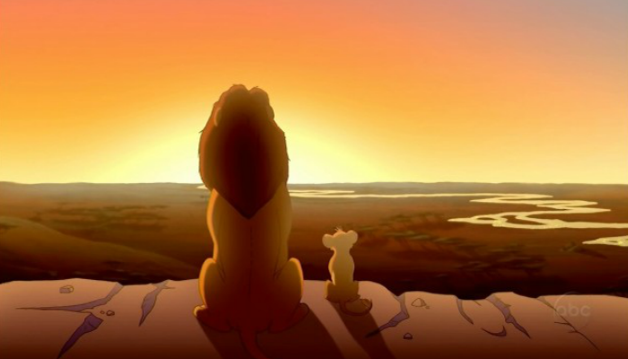
Ezra 4:11
To King Artaxerxes from your servants, the men of the region beyond the River, and so forth…
The Euphrates River served as a natural boundary between the “Promised Land” and the Eastern World.

Slide 16
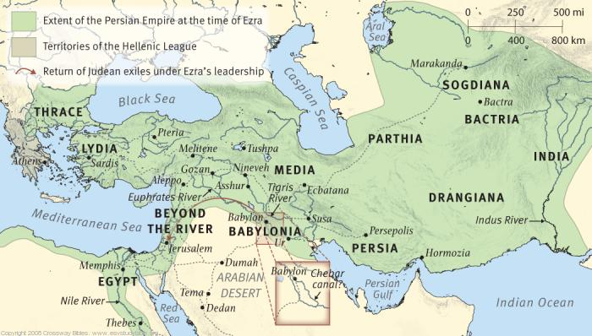

Slide 17
Jeremiah 46:1-2
The word of the Lord which came to Jeremiah the prophet against the nations.
² Against Egypt.
Concerning the army of Pharaoh Necho, king of Egypt, which was by the River Euphrates in Carchemish, and which Nebuchadnezzar king of Babylon defeated in the fourth year of Jehoiakim the son of Josiah, king of Judah:

Slide 18
2 Kings 23:29
In his days Pharaoh Necho king of Egypt went to the aid of the king of Assyria, to the River Euphrates; and King Josiah went against him. And Pharaoh Necho killed him at Megiddo when he confronted him.

Slide 19
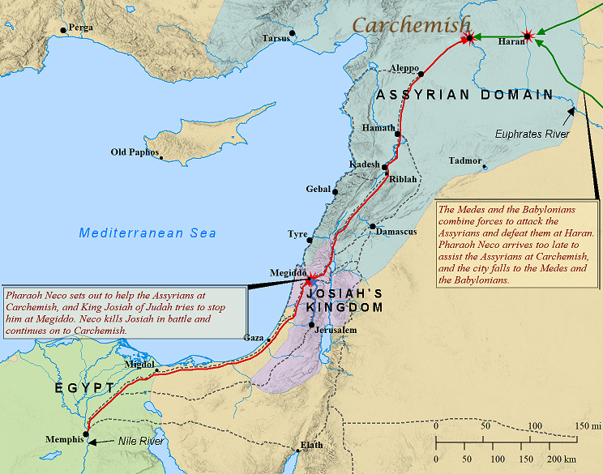
Ninevah
Ninevah
Babylon

Slide 20
Revelation 9:13-14
Then the sixth angel sounded: And I heard a voice from the four horns of the golden altar which is before God, ¹⁴ saying to the sixth angel who had the trumpet, “Release the four angels who are bound at the great river Euphrates.”

Slide 21
Revelation 9:15-16
So the four angels, who had been prepared for the hour and day and month and year, were released to kill a third of mankind. ¹⁶ Now the number of the army of the horsemen was two hundred million; I heard the number of them.
Remember, the book of Revelation is written in symbols and is not meant to be taken literally!

Slide 22
US Today, 7/20/2023
According to Statista:
The top 10 largest militaries based on active personnel:
China - 2,000,000
India - 1,450,000
United States - 1,390,000
North Korea - 1,200,000
Russia - 850,000
Pakistan - 640,000
Iran - 575,000
South Korea - 555,000
Vietnam - 470,000
Egypt - 450,000

Slide 23
Revelation 16:12
Then the sixth angel poured out his bowl on the great river Euphrates, and its water was dried up, so that the way of the kings from the east might be prepared.

Slide 24
Mighty Euphrates River

Slide 25
Experts: Euphrates will be dry in 2040!

Slide 26
Jeremiah 50:35-38
“A sword is against the Chaldeans,” says the Lord, “Against the inhabitants of Babylon, And against her princes and her wise men. ³⁶ A sword is against the soothsayers, and they will be fools. A sword is against her mighty men, and they will be dismayed. ³⁷ A sword is against their horses, Against their chariots, And against all the mixed peoples who are in her midst; And they will become like women. A sword is against her treasures, and they will be robbed. ³⁸ A drought is against her waters, and they will be dried up. For it is the land of carved images, And they are insane with their idols.

Slide 27
No More Euphrates?
Symbolically, this meant that the border that separated nations would be removed and nations would be overcome.
For Babylon, circa 539 BC (Jeremiah), it meant that the Medes and Persians from beyond the river (Kings from the East) would be able to overrun the great Empire.
For Rome, circa 54 BC – AD 217 (Revelation), it meant that the Parthians from beyond the river (Kings from the East) would be able to overrun the great Empire.

Slide 29
Revelation 16:15-16
Behold, I am coming as a thief. Blessed is he who watches, and keeps his garments, lest he walk naked and they see his shame.”
¹⁶ And they gathered them together to the place called in Hebrew, ^{[h]}Armageddon.
[h] Revelation 16:16 Lit. Mount Megiddo; M Megiddo

Slide 30
QUESTIONS

