Slide 1
Questions Answered by the Tabernacle
March 29, 2015
San Angelo, Tx

Slide 2
Exodus 26:30
And you shall raise up the tabernacle according to its pattern which you were shown on the mountain.

Slide 3
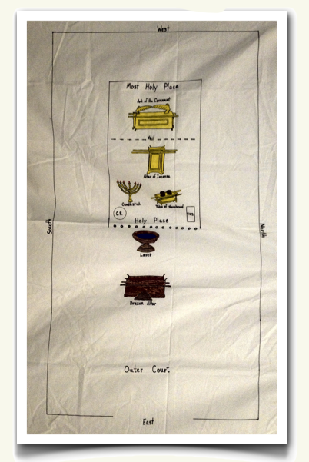

Slide 4
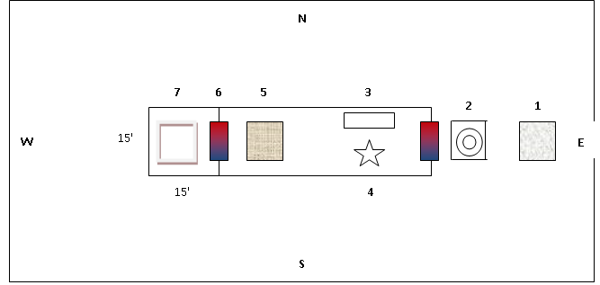

Slide 5
OUTER COURT
1 Brazen Altar of Burnt Offerings
2 Laver
HOLY PLACE
3 Table of Showbread
4 Lampstand
5 Altar of Incense
6 Veil
MOST HOLY PLACE
7 Ark of the Covenant (with Mercy Seat)

Slide 6
UNDERSTANDING THE SYMBOLS
Sacrifice of Jesus on the cross
Baptism
Lord’s Supper
Revelation of God’s Word through Jesus
Prayer and praise to God
Flesh of Jesus
God’s throne

Slide 7
UNDERSTANDING THE SYMBOLS
OUTER COURT = WORLD
HOLY PLACE = CHURCH
MOST HOLY PLACE = HEAVEN

Slide 8
QUESTION #1
Should we baptize infants and small children?

Slide 9
ANSWER
No
The Brazen Altar of Burnt Offerings represented the sacrifice of Jesus
The laver represented baptism
An infant is baptized without understanding or appreciating the sacrifice of Jesus
The altar has been placed before the laver!!

Slide 10
ADDITIONAL VERSES
Mark 10:14-15
2 Samuel 24:24

Slide 12
QUESTION #2
Why does the church of Christ not have a separate clergy?

Slide 13
ANSWER
Unnecessary
Under the Law of Moses, only priests were allowed to enter the Holy Place.
Priests wore special clothes to separate themselves from the people.
Under the New Testament, we are all priests!
Separation of the priesthood is unnecessary.

Slide 14
1 Peter 2:9
But you are a chosen generation, a royal priesthood, a holy nation, His own special people, that you may proclaim the praises of Him who called you out of darkness into His marvelous light;

Slide 15
Revelation 1:5-6
To Him who loved us and washed us from our sins in His own blood, ⁶ and has made us kings and priests to His God and Father, to Him be glory and dominion forever and ever. Amen.

Slide 16
ADDITIONAL VERSES
Matthew 23:9
Revelation 5:10. 20:6

Slide 18
QUESTION #3
Are extra creeds necessary for salvation?

Slide 19
ANSWER
No
The Holy Place was illuminated by the Golden Lampstand.
The Lampstand represented the revelation of God’s Word through Jesus.
The only light of the Holy Place came from the lamp.
Adding other creeds would be the same as adding additional light to the Holy Place!

Slide 20
John 1:1
In the beginning was the Word, and the Word was with God, and the Word was God.

Slide 21
John 8:12
Then Jesus spoke to them again, saying, “I am the light of the world. He who follows Me shall not walk in darkness, but have the light of life.”

Slide 22
Psalm 119:130
The entrance of Your words gives light; It gives understanding to the simple.

Slide 23
ADDITIONAL VERSES
Galatians 1:6-10
2 Timothy 3:16

Slide 25
QUESTION #4
Some say that baptism is optional and that salvation comes through belief only. Is this correct?

Slide 26
ANSWER
No
Baptism is essential for salvation.
The laver represents baptism.
All priests were commanded be consecrated once by the washing at the laver…
…before entering the Holy Place.
Removing baptism is no different than removing the laver from the tabernacle!

Slide 27
Mark 16:16
He who believes and is baptized will be saved; but he who does not believe will be condemned.

Slide 28
ADDITIONAL VERSES
James 2:19

Slide 30
QUESTION #5
What is the benefit of the “Sinner’s Prayer”?
Lord Jesus,
I now confess to You all of the wrong and sinful things that I have ever done in my life. I ask that You please forgive me and wash away all of my sins and that You have personally shed for me on the cross. I am now ready to accept You as my personal Lord and Savior. I now ask that You come into my life and live with me for all of eternity. Father, Jesus – I now believe that I am truly saved and born again.

Slide 31
ANSWER
Nothing
The Altar of Incense represents prayer and praise to God.
This altar was located in the Holy Place, and was only accessible by the priests.
Prayer is a privilege of God’s people, not alien sinners!
The Sinner’s Prayer would require the altar of incense to be moved into the outer court.

Slide 32
ADDITIONAL VERSES
Proverbs 15:29

Slide 34
QUESTION #6
Does a person need to be a member of the church to go to Heaven?

Slide 35
ANSWER
Yes
There was only one entrance for each area of the tabernacle, all coming from the east.
The Outer Court represents the World, the Holy Place the Church, and the Most Holy Place represents Heaven.
How else can one get from the world to Heaven?
What do people have against the Church?

Slide 36
John 10:9
I am the door and all that seek entrance must come through me

Slide 37
ADDITIONAL VERSES
1 Peter 3:21-22

Slide 39
QUESTION #7
Are members of the Church of Christ the only people going to Heaven?
Different Question:
Are those that follow the pattern the only people going to Heaven?

Slide 40
ANSWER
Yes
This question removes any personal feeling, thus becoming very objective.
There is no other means by which to enter the Most Holy Place.
If something in our religion does not fit, we need to get rid of it!

Slide 41
Hebrews 8:1-2
Now this is the main point of the things we are saying: We have such a High Priest, who is seated at the right hand of the throne of the Majesty in the heavens, ² a Minister of the sanctuary and of the true tabernacle which the Lord erected, and not man.

Slide 43
Conclusion
Most problems in the religious world today come from a lack of understanding of God’s pattern.
Many folks are guilty of “Rearranging the furniture in God’s house”
Just like Moses, we have been given a pattern. God expects us to follow it.
Is there anything that does not fit that needs to be removed?

