Slide 2
Stephen’s Sermon Location, Location, Location
December 17, 2023
San Angelo, TX

Slide 3
As we read the words of Stephen, ask yourself this question:
Why would this sermon make the Jews angry enough to stone the preacher to death?

Slide 4
Acts 7:1
Then the high priest said, “Are these things so?”
And with this prompt, so begins Stephen’s defense before the Sanhedrin Council.

Slide 6
Abraham

Slide 7
Acts 7:2-3
And he said, “Brethren and fathers, listen: The God of glory appeared to our father Abraham when he was in Mesopotamia, before he dwelt in Haran, ³ and said to him, ‘Get out of your country and from your relatives, and come to a land that I will show you.’

Slide 9
Patriarchs

Slide 10
Acts 7:6-8
⁶ But God spoke in this way: that his descendants would dwell in a foreign land, and that they would bring them into bondage and oppress them four hundred years. ⁷ ‘And the nation to whom they will be in bondage I will judge,’ said God, ‘and after that they shall come out and serve Me in this place.’ ⁸ Then He gave him the covenant of circumcision; and so Abraham begot Isaac and circumcised him on the eighth day; and Isaac begot Jacob, and Jacob begot the twelve patriarchs.

Slide 11
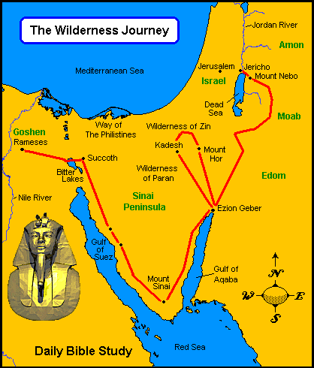

Slide 12
Acts 7:9-10
And the patriarchs, becoming envious, sold Joseph into Egypt. But God was with him ¹⁰ and delivered him out of all his troubles
(Genesis 39:2)
The Lord was with Joseph, and he was a successful man

Slide 13
Acts 7:11
Now a famine and great trouble came over all the land of Egypt and Canaan, and our fathers found no sustenance.

Slide 14
Acts 7:12-15a
But when Jacob heard that there was grain in Egypt, he sent out our fathers first. ¹³ And the second time Joseph was made known to his brothers, and Joseph’s family became known to the Pharaoh. ¹⁴ Then Joseph sent and called his father Jacob and all his relatives to him, seventy-five people.

Slide 15
Acts 7:15-16
So Jacob went down to Egypt; and he died, he and our fathers. And they were carried back to Shechem and laid in the tomb that Abraham bought for a sum of money from the sons of Hamor, the father of Shechem.

Slide 16
Shechem
Shechem was a city located in the land of Samaria. Yes, Jacob (as well as the other Patriarchs) was buried in Samaria! This was embarrassing to the Jews who hated Samaria.

Slide 17
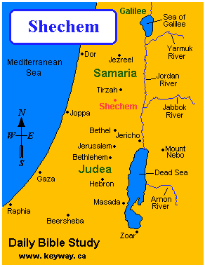
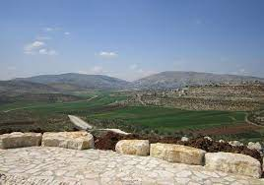
Mt. Gerizim

Slide 18
John 4:20-21
Our fathers worshiped on this mountain, and you Jews say that in Jerusalem is the place where one ought to worship.”
²¹ Jesus said to her, “Woman, believe Me, the hour is coming when you will neither on this mountain, nor in Jerusalem, worship the Father.
HERE IS THE FOCUS OF STEPHEN’S SERMON!!

Slide 19
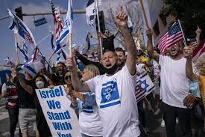
Imagine reminding a rapid Israeli supporter that their founding fathers are actually buried in Palestine!

Slide 20
Moses

Slide 21
Acts 7:20, 29-30
At this time Moses was born, and was well pleasing to God; and he was brought up in his father’s house for three months.
Then, at this saying, Moses fled and became a dweller in the land of Midian, where he had two sons. ³⁰And when forty years had passed, an Angel of the Lord appeared to him in a flame of fire in a bush, in the wilderness of Mount Sinai.

Slide 23
Acts 7:36
He brought them out, after he had shown wonders and signs in the land of Egypt, and in the Red Sea, and in the wilderness forty years.

Slide 24
Acts 7:37-39
“This is that Moses who said to the children of Israel, ‘The Lord your God will raise up for you a Prophet like me from your brethren. Him you shall hear.’
³⁸ “This is he who was in the congregation in the wilderness with the Angel who spoke to him on Mount Sinai, and with our fathers, the one who received the living oracles to give to us, ³⁹ whom our fathers would not obey, but rejected.
10 Commandments

Slide 25
Joshua

Slide 26
Acts 7:44-45
Our fathers had the tabernacle of witness in the wilderness, as He appointed, instructing Moses to make it according to the pattern that he had seen, ⁴⁵ which our fathers, having received it in turn, also brought with Joshua into the land possessed by the Gentiles, whom God drove out before the face of our fathers…

Slide 27
David

Slide 28
Acts 7:45-46
…brought with Joshua into the land possessed by the Gentiles, whom God drove out before the face of our fathers until the days of David, ⁴⁶ who found favor before God and asked to find a dwelling for the God of Jacob.

Slide 29
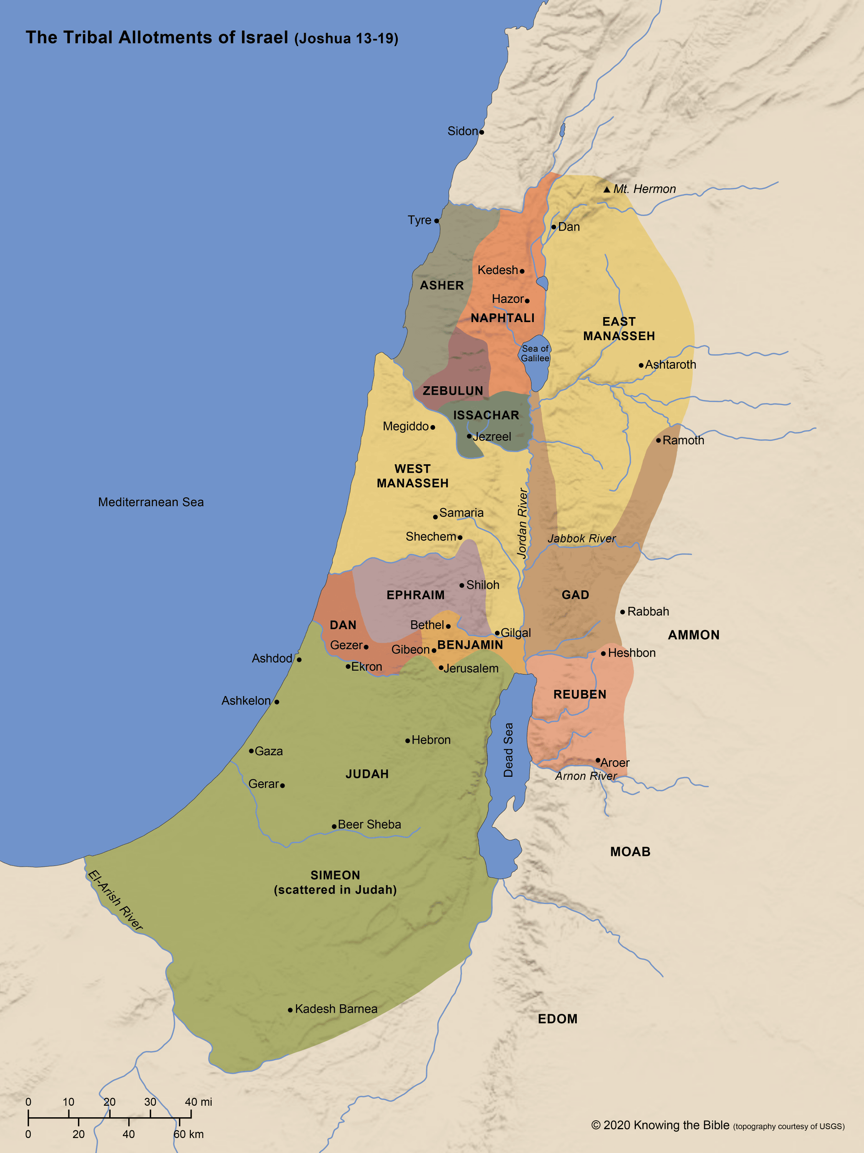

Slide 30
Solomon

Slide 31
Acts 7:47
But Solomon built Him a house.

Slide 33
LOCATION, LOCATION, LOCATION
What was the purpose of Stephen’s sermon from Acts 7?
God was with Abraham in Mesopotamia.
God was with Jacob and the patriarchs in Canaan, Egypt and Shechem.
God was with Moses in Egypt and in Sinai.
God was with Joshua as he took the land of the Gentiles (Israel).
God was with David and Solomon in Jerusalem.
The world did not revolve around the Temple at Jerusalem!

Slide 34
Acts 7:48-50
“However, the Most High does not dwell in temples made with hands, as the prophet says:
⁴⁹ ‘Heaven is My throne, And earth is My footstool. What house will you build for Me? says the Lord, Or what is the place of My rest? ⁵⁰ Has My hand not made all these things?’

Slide 35
John 4:20-21
Our fathers worshiped on this mountain, and you Jews say that in Jerusalem is the place where one ought to worship.”
²¹ Jesus said to her, “Woman, believe Me, the hour is coming when you will neither on this mountain, nor in Jerusalem, worship the Father.
HERE IS THE FOCUS OF STEPHEN’S SERMON!!

Slide 36
Acts 7:51-53
“You stiff-necked and uncircumcised in heart and ears! You always resist the Holy Spirit; as your fathers did, so do you. ⁵² Which of the prophets did your fathers not persecute? And they killed those who foretold the coming of the Just One, of whom you now have become the betrayers and murderers, ⁵³ who have received the law by the direction of angels and have not kept it.”

Slide 37
Acts 7:54-58
When they heard these things they were cut to the heart, and they gnashed at him with their teeth. ⁵⁵ But he, being full of the Holy Spirit, gazed into heaven and saw the glory of God, and Jesus standing at the right hand of God, ⁵⁶ and said, “Look! I see the heavens opened and the Son of Man standing at the right hand of God!”
⁵⁷ Then they cried out with a loud voice, stopped their ears, and ran at him with one accord; ⁵⁸ and they cast him out of the city and stoned him.

Slide 38
CONCLUSION
Stephen used examples of the past to show that God would protect the faithful regardless of location.
Stephen had been charged with speaking out against the Temple….which in fact he was guilty of.
Christianity ushered in a new era, where worship was not to be centered in Jerusalem at the Temple.

