Slide 1
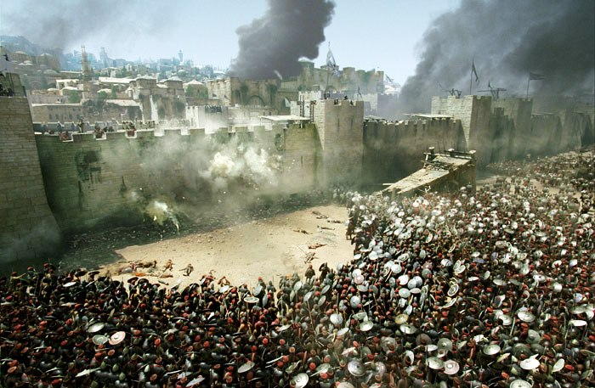
The Fall of Jerusalem
AD 66- 70

Slide 3
Signs of the end of the (Jewish) age
False Messiahs
Wars and Rumors of Wars
Famines
Pestilences
Earthquakes
Christian tribulations
False prophets
Falling away
Spreading of the Gospel worldwide

Slide 4
Matthew 24:34
Assuredly, I say to you, this generation will by no means pass away till all these things take place.

Slide 5
False Messiahs
NON-BIBLICAL
Menahem
Simon the Proselyte
BIBLICAL
Theudas of Judea
Judas of Galilee
“The Egyptian”

Slide 6
Acts 5:33-34 Theudas & Judas
For some time ago Theudas rose up, claiming to be somebody. A number of men, about four hundred, joined him. He was slain, and all who obeyed him were scattered and came to nothing.
³⁷ After this man, Judas of Galilee rose up in the days of the census, and drew away many people after him. He also perished, and all who obeyed him were dispersed.

Slide 7
Acts 21:38 “The Egyptian”
Are you not the Egyptian who some time ago stirred up a rebellion and led the four thousand assassins out into the wilderness?”

Slide 8
Wars and Rumors of Wars
The time of Jesus was part of what the Romans called “Pax Romana”, or the “Roman Peace”. It was a time of great stability in the Empire.
This would all change by the year AD 68, when there were extensive civil wars raging across the Empire during the so-called “Year of the Four Emperors”.

Slide 9
Famines
AD 40-41 Rome
AD 45-47 Egypt
AD 46-48 Jerusalem (Queen Helena)

Slide 10
Acts 11:27-28
Then one of them, named Agabus, stood up and showed by the Spirit that there was going to be a great famine throughout all the world, which also happened in the days of Claudius Caesar.

Slide 11
Earthquakes
AD 46 Crete
AD 51 Rome
AD 53 Apamaia
AD 60-62 Laodicea, Colossae, Hierpolis
AD 62 Campania
AD 63 Pompeii

Slide 12
Acts 16:26 Philippi
Suddenly there was a great earthquake, so that the foundations of the prison were shaken; and immediately all the doors were opened and everyone’s chains were loosed.

Slide 13
Christian tribulations
Peter and John (Acts 4)
Stephen (Acts 7)
James (Acts 12)
Paul
Tradition holds Peter was killed in Rome in AD 64, while Paul met his fate in 66. Of the Apostles, only John was believed to live out a natural life, and that was with banishment to Patmos.

Slide 14
False Prophets
Jude 4
For certain men have crept in unnoticed, who long ago were marked out for this condemnation, ungodly men, who turn the grace of our God into lewdness and deny the only Lord God and our Lord Jesus Christ.

Slide 15
Falling Away
1 Timothy 1:18-19
This charge I commit to you, son Timothy, according to the prophecies previously made concerning you, that by them you may wage the good warfare, ¹⁹ having faith and a good conscience, which some having rejected, concerning the faith have suffered shipwreck

Slide 16
Spreading of the Gospel
After the Day of Pentecost, the Church grew rapidly. By the writing of the book of Colossians (in approximately AD 60-62), the Apostle Paul felt comfortable enough to declare that the Gospel had been taught to “every creature under heaven”. (Colossians 1:23)

Slide 17
Colossians 1:5-6
…because of the hope which is laid up for you in heaven, of which you heard before in the word of the truth of the gospel, ⁶ which has come to you, as it has also in all the world

Slide 18
Signs of the end of the (Jewish) age
In the years following the life of Jesus, all of the signs that He predicted had come true. There was no excuse for the Christian NOT to know what was coming!

Slide 19
Matthew 24:32
“Now learn this parable from the fig tree: When its branch has already become tender and puts forth leaves, you know that summer is near.

Slide 20
Jerusalem would fall!
Matthew 23:37-38
“O Jerusalem, Jerusalem, the one who kills the prophets and stones those who are sent to her! How often I wanted to gather your children together, as a hen gathers her chicks under her wings, but you were not willing! ³⁸ See! Your house is left to you desolate

Slide 21
Matthew 21:13 “My House”
“It is written, ‘My house shall be called a house of prayer,’ but you have made it a ‘den of thieves.’”

Slide 22
Matthew 23:38 “Your House”
See! Your house is left to you desolate

Slide 23
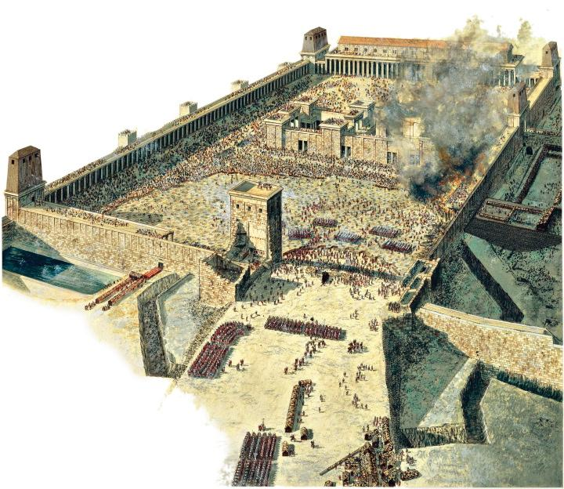
The Fall of Jerusalem

Slide 24
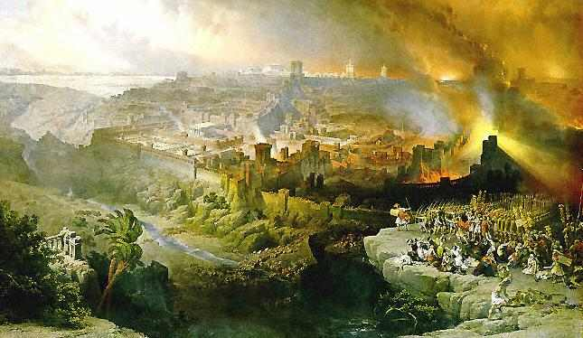
The Fall of Jerusalem

Slide 25
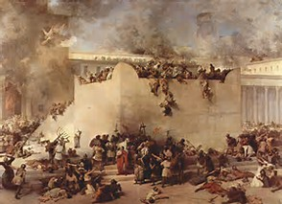
The Fall of Jerusalem

Slide 26
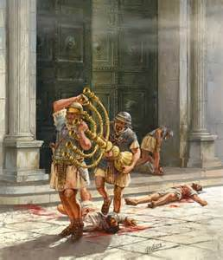
The Fall of Jerusalem

Slide 27
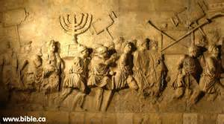
The Fall of Jerusalem

Slide 28
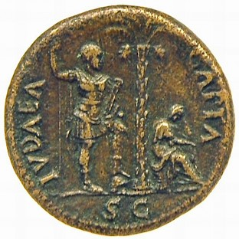
The Fall of Jerusalem

