Slide 2
The valley of hinnom
October 23, 2022
San Angelo, TX

Slide 3
Jeremiah 19:4-6
“Because they have forsaken Me and made this an alien place, because they have burned incense in it to other gods whom neither they, their fathers, nor the kings of Judah have known, and have filled this place with the blood of the innocents ⁵ (they have also built the high places of Baal, to burn their sons with fire for burnt offerings to Baal, which I did not command or speak, nor did it come into My mind), ⁶ therefore behold, the days are coming,” says the Lord, “that this place shall no more be called Tophet or the Valley of the Son of Hinnom, but the Valley of Slaughter.

Slide 5
Church of Christ 101
Worship
Communion
Contribution
Singing
Prayer
Teaching
We also must teach the reality of Hell and its danger!

Slide 6
Joshua 15:8
And the border went up by the Valley of the Son of Hinnom to the southern slope of the Jebusite city (which is Jerusalem). The border went up to the top of the mountain that lies before the Valley of Hinnom westward…

Slide 7
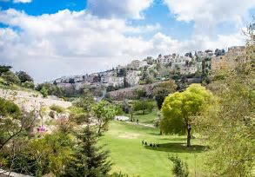
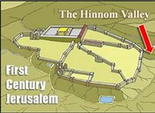
The Valley of Hinnom

Slide 8
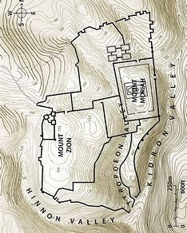
Jerusalem and its Hills

Slide 9
Who is Hinnom?
History does not record anything about the origins of the ancient hero Hinnom (or Hinnon) or his son.
However, very early in its history the valley became associated with the worship of the Ammonite god Moloch.

Slide 10
Leviticus 18:21
And you shall not let any of your descendants pass through the fire to Molech, nor shall you profane the name of your God: I am the Lord.

Slide 11
Leviticus 20:1-3
Then the Lord spoke to Moses, saying, ² “Again, you shall say to the children of Israel: ‘Whoever of the children of Israel, or of the strangers who dwell in Israel, who gives any of his descendants to Molech, he shall surely be put to death. The people of the land shall stone him with stones. ³ I will set My face against that man, and will cut him off from his people, because he has given some of his descendants to Molech, to defile My sanctuary and profane My holy name.

Slide 12
Who is Milcom – Got Questions.com
“Moloch/Molech/Molek,” which could be interpreted as “the personified ruler of shameful sacrifice.” It has also been spelled Milcom, Milkim, and Malik.
In addition to sexual rituals, Phoenician Moloch worship included child sacrifice, or “passing children through the fire.” It is believed that idols of Moloch were giant metal statues of a man with a bull’s head. Each image had a hole in the abdomen and possibly outstretched forearms that made a kind of ramp to the hole. A fire was lit in or around the statue. Babies were placed in the statue’s arms or in the hole.

Slide 13
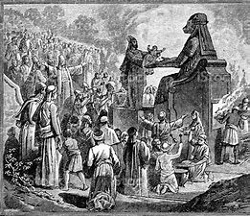

Slide 14
Zephaniah 1:4-5
“I will stretch out My hand against Judah, And against all the inhabitants of Jerusalem. I will cut off every trace of Baal from this place, The names of the idolatrous priests with the pagan priests— ⁵ Those who worship the host of heaven on the housetops; Those who worship and swear oaths by the Lord, But who also swear by Milcom; ⁶ Those who have turned back from following the Lord, And have not sought the Lord, nor inquired of Him.”

Slide 15
Tophet
There was a particular part of the Valley of Hinnom that was known as Tophet (or Topheth).
2 possible Hebrew translations:
“to burn”
“to drum”
This area was the graveyard of the massacred infants.

Slide 16
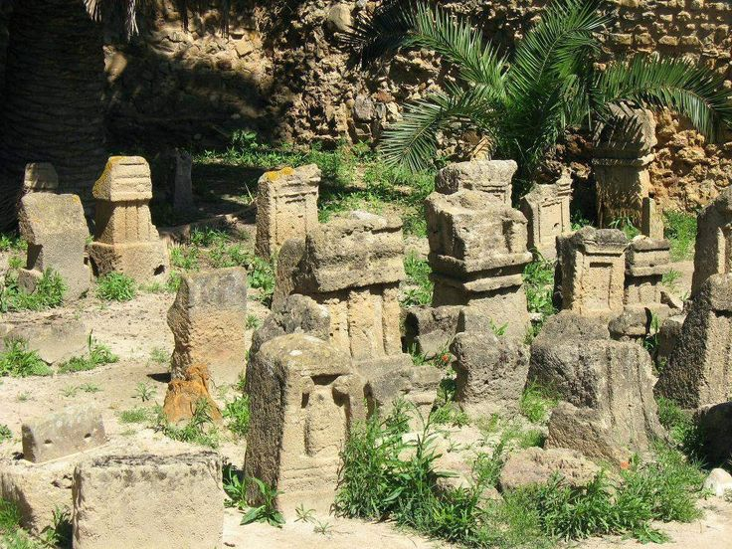
A Topheth in Carthage
Archaeologists have applied the term "tophet" to large cemeteries of children found at Carthaginian sites that have traditionally been believed to house the victims of child sacrifice

Slide 17
2 Chronicles 33:1, 5-6
Manasseh was twelve years old when he became king, and he reigned fifty-five years in Jerusalem.
⁵ And he built altars for all the host of heaven in the two courts of the house of the Lord. ⁶ Also he caused his sons to pass through the fire in the Valley of the Son of Hinnom; he practiced soothsaying, used witchcraft and sorcery, and consulted mediums and spiritists. He did much evil in the sight of the Lord, to provoke Him to anger.

Slide 18
2 Kings 23:10
And he [Josiah] defiled Topheth, which is in the Valley of the Son of Hinnom, that no man might make his son or his daughter pass through the fire to Molech.

Slide 19
Jeremiah 19:4-6
“Because they have forsaken Me and made this an alien place, because they have burned incense in it to other gods whom neither they, their fathers, nor the kings of Judah have known, and have filled this place with the blood of the innocents ⁵ (they have also built the high places of Baal, to burn their sons with fire for burnt offerings to Baal, which I did not command or speak, nor did it come into My mind), ⁶ therefore behold, the days are coming,” says the Lord, “that this place shall no more be called Tophet or the Valley of the Son of Hinnom, but the Valley of Slaughter.

Slide 20
Jeremiah 19:11-13
‘Thus says the Lord of hosts: “Even so I will break this people and this city, as one breaks a potter’s vessel, which cannot be made whole again; and they shall bury them in Tophet till there is no place to bury. ¹² Thus I will do to this place,” says the Lord, “and to its inhabitants, and make this city like Tophet. ¹³ And the houses of Jerusalem and the houses of the kings of Judah shall be defiled like the place of Tophet, because of all the houses on whose roofs they have burned incense to all the host of heaven, and poured out drink offerings to other gods.” ’ ”

Slide 21
Isaiah 30:33
For Tophet was established of old, Yes, for the king it is prepared. He has made it deep and large; Its pyre is fire with much wood; The breath of the Lord, like a stream of brimstone, Kindles it.

Slide 22
From Hebrew to Greek
Valley of Hinnom → Ge bene Hinnom → Gêhinnōm → Gehenna
With this well-known visual in mind, Jesus spoke of Gehenna some 12 times in the Gospels, translated as “Hell” in the King James Version.

Slide 23
Matthew 5:27-30
“You have heard that it was said to those of old, ‘You shall not commit adultery.’ ²⁸ But I say to you that whoever looks at a woman to lust for her has already committed adultery with her in his heart. ²⁹ If your right eye causes you to [sin, pluck it out and cast it from you; for it is more profitable for you that one of your members perish, than for your whole body to be cast into hell. ³⁰ And if your right hand causes you to sin, cut it off and cast it from you; for it is more profitable for you that one of your members perish, than for your whole body to be cast into hell.

Slide 24
Matthew 10:28
And do not fear those who kill the body but cannot kill the soul. But rather fear Him who is able to destroy both soul and body in ^{[h]}hell.
FOOTNOTE
Gr. Gehenna

Slide 25
Mark 9:47-48
And if your eye causes you to sin, pluck it out. It is better for you to enter the kingdom of God with one eye, rather than having two eyes, to be cast into hell fire— ⁴⁸ where
‘Their worm does not die And the fire is not quenched.’

Slide 26
Matthew 23:33
Serpents, brood of vipers [scribes and Pharisees]! How can you escape the condemnation of hell?

Slide 27
Conclusion
Do we have a complete understanding of Hell?
When Jesus wanted to use a visual representation of Hell, he chose to use Gehenna, or the “Valley of Hinnom”.
Can you imagine a more ungodly, horrible place than what was described by the visual of Gehenna?

Slide 28
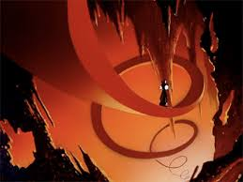
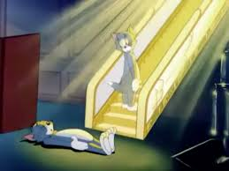
Our Culture Does Not Understand Heaven and Hell!

Slide 29
HELL
IS
REAL!

