Slide 2
Three that bear witness 1 john 5:6-8
June 18, 2023
San Angelo, TX

Slide 4
1 John 5:6-8
This is He who came by water and blood—Jesus Christ; not only by water, but by water and blood. And it is the Spirit who bears witness, because the Spirit is truth. ⁷ For there are three that bear witness in heaven: the Father, the Word, and the Holy Spirit; and these three are one. ⁸ And there are three that bear witness on earth: the Spirit, the water, and the blood; and these three agree as one.

Slide 5
1 John 5:6-8
This is He who came by water and blood—Jesus Christ; not only by water, but by water and blood. And it is the Spirit who bears witness, because the Spirit is truth. ⁷ For there are three that bear witness ^{[b]}in heaven: the Father, the Word, and the Holy Spirit; and these three are one. ⁸ And there are three that bear witness on earth: the Spirit, the water, and the blood; and these three agree as one.
^{[b]} 1 John 5:7 NU, M omit the words from in heaven (v. 7) through on earth (v. 8). Only 4 or 5 very late mss. contain these words in Greek.

Slide 6
1 John 5:6-8
This is He who came by water and blood—Jesus Christ; not only by water, but by water and blood. And it is the Spirit who bears witness, because the Spirit is truth. ⁷ For there are three that bear witness ^{[b]}in heaven: the Father, the Word, and the Holy Spirit; and these three are one. ⁸ And there are three that bear witness on earth: the Spirit, the water, and the blood; and these three agree as one.

Slide 7
1 John 5:6-8
This is he who came by water and blood, Jesus Christ, not with the water only but with the water and the blood. ⁷ And the Spirit is the witness, because the Spirit is the truth. ⁸ There are three witnesses, the Spirit, the water, and the blood; and these three agree. (RSV)

Slide 8
Wayne Fussell, Church of Christ Evangelist
“I have always been reluctant to accept the claims of the critics when they deny portions of the Bible are genuine: however, in this case, the evidence seems to be overwhelming that this verse was added by an overly ambitious scribe in copying the New Testament.”
Contending for the Faith Commentary p. 367

Slide 9
1 John 5:7-8
And the Spirit is the witness, because the Spirit is the truth. ⁸ There are three witnesses, the Spirit, the water, and the blood; and these three agree. (RSV)
9th Commandment: “You shall not bear false witness against your neighbor.”

Slide 10
John 14:15-17
“If you love Me, keep My commandments. ¹⁶ And I will pray the Father, and He will give you another Helper, that He may abide with you forever— ¹⁷ the Spirit of truth, whom the world cannot receive, because it neither sees Him nor knows Him; but you know Him, for He dwells with you and will be in you.
John’s Fugue
Love
Truth

Slide 11
Truth and Love
If our message has TRUTH without LOVE, this is known as LEGALISM.
If our message has LOVE without TRUTH, this is known as LIBERALISM.
LIBERALISM
LEGALISM

Slide 12
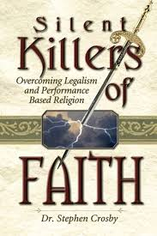
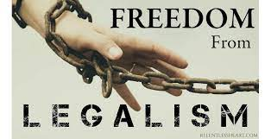
Methodist: UMC or Global?
SBC Convention: 6/13/23

Slide 13
1 John 5:7-8
And the Spirit is the witness, because the Spirit is the truth. ⁸ There are three witnesses, the Spirit, the water, and the blood; and these three agree. (RSV)

Slide 14
Witness
It is a Biblical concept to need 2 or 3 witnesses in order to prove adequate testimony.
(Deuteronomy 17:6)
Whoever is deserving of death shall be put to death on the testimony of two or three witnesses; he shall not be put to death on the testimony of one witness.
(Matthew 18:16)
But if he will not hear, take with you one or two more, that ‘by the mouth of two or three witnesses every word may be established.’

Slide 15
Hebrews 10:28-29
Anyone who has rejected Moses’ law dies without mercy on the testimony of two or three witnesses. ²⁹ Of how much worse punishment, do you suppose, will he be thought worthy who has trampled the Son of God underfoot, counted the blood of the covenant by which he was sanctified a common thing, and insulted the Spirit of grace?
3 Witnesses of Law of Christ:
Son of God
Blood of the covenant
Spirit of grace

Slide 16
1 John 5:7-8
And the Spirit is the witness, because the Spirit is the truth. ⁸ There are three witnesses, the Spirit, the water, and the blood; and these three agree. (RSV)
Why the need for witnesses?

Slide 17
Cerinthus – False teacher of John’s Day
He taught…
That the world was created, not by God, but by a power far separated from Him
That Jesus was the natural son of Joseph and Mary, although he was more righteous, prudent, and wise than other men
That at Jesus’ baptism the Christ descended upon Him in the likeness of a dove, providing Him miraculous powers
That at His death the Christ departed from Him, so that it was only the human Jesus that died and rose again.
BATH HOUSE STORY?

Slide 18
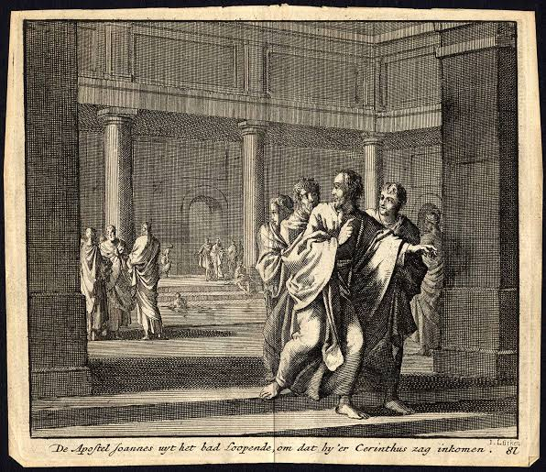

Slide 19
1 John 5:7-8
And the Spirit is the witness, because the Spirit is the truth. ⁸ There are three witnesses, the Spirit, the water, and the blood; and these three agree. (RSV)
3 Witnesses of Jesus the Christ:
Spirit
Water
Blood

Slide 20
1 John 4:2-3
By this you know the Spirit of God: Every spirit that confesses that Jesus Christ has come in the flesh is of God, ³ and every spirit that does not confess that Jesus Christ has come in the flesh is not of God.
Cerinthus was an example of this false spirit, and was not of God!

Slide 21
1 John 5:5
Who is he who overcomes the world, but he who believes that Jesus is the Son of God?
(Acts 8:36-37)
Now as they went down the road, they came to some water. And the eunuch said, “See, here is water. What hinders me from being baptized?”
³⁷ Then Philip said, “If you believe with all your heart, you may.” And he answered and said, “I believe that Jesus Christ is the Son of God.”

Slide 22
Water and Blood
Baptism of Jesus and Crucifixion
Incarnation
Water and blood flowed from His side on the cross
Believer baptism and Lord’s Supper
Birth of Jesus – both man and deity

Slide 23
Blood During Childbirth: Purification
(Leviticus 12)
‘If a woman has conceived, and borne a male child, then she shall be unclean seven days; as in the days of her customary impurity she shall be unclean.
⁴ She shall then continue in the blood of her purification thirty-three days
(Luke 2:22)
Now when the days of her [Mary] purification according to the law of Moses were completed, they brought Him [Jesus] to Jerusalem to present Him to the Lord
All these interpretations come back to the understanding of the union of the humanity and the deity of Jesus.

Slide 24
1 John 5:7-8
And the Spirit is the witness, because the Spirit is the truth. ⁸ There are three witnesses, the Spirit, the water, and the blood; and these three agree. (RSV)

Slide 25
Mark 14:55-56
Now the chief priests and all the council sought testimony against Jesus to put Him to death, but found none. ⁵⁶ For many bore false witness against Him, but their testimonies did not agree.
There is no misunderstanding. The entire life of Jesus, from His miraculous birth to His death on the cross, all tell us who Jesus is and why we should follow Him.

Slide 26
1 John 5:7-8
And the Spirit is the witness, because the Spirit is the truth. ⁸ There are three witnesses, the Spirit, the water, and the blood; and these three agree. (RSV)
3 Witnesses of the Christ:
Holy Spirit
Humanity of Jesus
Deity of Jesus

