Slide 2
Zechariah Biblical History
June 28, 2023
San Angelo, TX

Slide 3
Zechariah 1:1
In the eighth month of the second year of Darius, the word of the Lord came to Zechariah the son of Berechiah, the son of Iddo the prophet,

Slide 4
1 Chronicles 17:1-4
Now it came to pass, when David was dwelling in his house, that David said to Nathan the prophet, “See now, I dwell in a house of cedar, but the ark of the covenant of the Lord is under tent curtains.”
² Then Nathan said to David, “Do all that is in your heart, for God is with you.”
³ But it happened that night that the word of God came to Nathan, saying, ⁴ “Go and tell My servant David, ‘Thus says the Lord: “You shall not build Me a house to dwell in.

Slide 5
1 Chronicles 17:11-12
And it shall be, when your days are fulfilled, when you must go to be with your fathers, that I will set up your seed after you, who will be of your sons; and I will establish his kingdom. ¹² He shall build Me a house, and I will establish his throne forever.

Slide 6
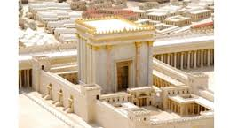
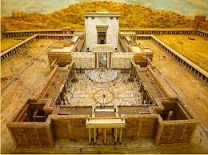
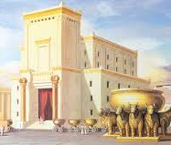

Slide 7
TIMELINE
557 BC Solomon’s Temple Completed

Slide 8
2 Kings 25:1, 8-9
Now it came to pass in the ninth year of his reign, in the tenth month, on the tenth day of the month, that Nebuchadnezzar king of Babylon and all his army came against Jerusalem and encamped against it; and they built a siege wall against it all around.
And in the fifth month, on the seventh day of the month (which was the nineteenth year of King Nebuchadnezzar king of Babylon), Nebuzaradan the captain of the guard, a servant of the king of Babylon, came to Jerusalem. ⁹ He burned the house of the Lord and the king’s house; all the houses of Jerusalem, that is, all the houses of the great, he burned with fire.

Slide 9
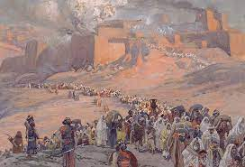
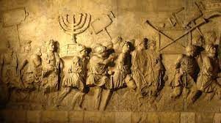
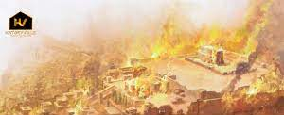
Temple Destroyed

Slide 10
TIMELINE
957 BC Solomon’s Temple Completed
587 BC Solomon’s Temple Destroyed

Slide 11
Jeremiah 25:8-11
“Therefore thus says the Lord of hosts: ‘Because you have not heard My words, ⁹ behold, I will send and take all the families of the north,’ says the Lord, ‘and Nebuchadnezzar the king of Babylon, My servant, and will bring them against this land, against its inhabitants, and against these nations all around, and will utterly destroy them, and make them an astonishment, a hissing, and perpetual desolations. ¹⁰ Moreover I will take from them the voice of mirth and the voice of gladness, the voice of the bridegroom and the voice of the bride, the sound of the millstones and the light of the lamp. ¹¹ And this whole land shall be a desolation and an astonishment, and these nations shall serve the king of Babylon seventy years.

Slide 12
70 Years of Servitude
Was it exactly 70 years?
1. The time of captivity was rounded to reach 70
2. The servitude to Babylon was 70 years, while the captivity was included in this time frame.
609 BC – 539 BC: The captivity was included during this time.

Slide 13
TIMELINE
957 BC Solomon’s Temple Completed
609 BC Fall of Assyria to Babylon
587 BC Solomon’s Temple Destroyed
539 BC Fall of Babylon to Persia

Slide 14
Ezra 1:1-2
Now in the first year of Cyrus king of Persia, that the word of the Lord by the mouth of Jeremiah might be fulfilled, the Lord stirred up the spirit of Cyrus king of Persia, so that he made a proclamation throughout all his kingdom, and also put it in writing, saying,
² Thus says Cyrus king of Persia:
All the kingdoms of the earth the Lord God of heaven has given me. And He has commanded me to build Him a ^{[a]}house at Jerusalem which is in Judah.
^{[a]} Temple

Slide 15
Ezra 3:8-11
Now in the second month of the second year of their coming to the house of God at Jerusalem... and all those who had come out of the captivity to Jerusalem, began work … to oversee the work of the house of the Lord.
¹⁰ When the builders laid the foundation of the temple of the Lord, the priests stood in their apparel with trumpets, and the Levites, the sons of Asaph, with cymbals, to praise the Lord, according to the ordinance of David king of Israel. ¹¹ And they sang responsively, praising and giving thanks to the Lord:
“For He is good, For His mercy endures forever toward Israel.”
Then all the people shouted with a great shout, when they praised the Lord, because the foundation of the house of the Lord was laid.

Slide 16
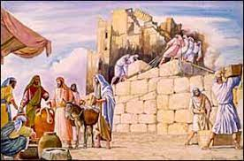
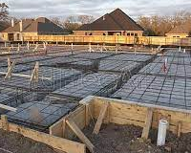

Slide 17
TIMELINE
957 BC Solomon’s Temple Completed
609 BC Fall of Assyria to Babylon
587 BC Solomon’s Temple Destroyed
539 BC Fall of Babylon to Persia
538 BC Foundation to Temple laid

Slide 18
Ezra 4:23-24
Now when the copy of King Artaxerxes’ letter was read …
they went up in haste to Jerusalem against the Jews, and by force of arms made them cease.
²⁴ Thus the work of the house of God which is at Jerusalem ceased, and it was discontinued until the second year of the reign of Darius king of Persia.

Slide 19
TIMELINE
957 BC Solomon’s Temple Completed
609 BC Fall of Assyria to Babylon
587 BC Solomon’s Temple destroyed
539 BC Fall of Babylon to Persia
538 BC Foundation to Temple laid
538-37 BC Temple construction halted

Slide 20
Haggai 1:1
In the second year of King Darius, in the sixth month, on the first day of the month, the word of the Lord came by Haggai the prophet … saying, ² “Thus speaks the Lord of hosts, saying:
Read v.2-11

Slide 21
Zechariah 1:1
In the eighth month of the second year of Darius, the word of the Lord came to Zechariah the son of Berechiah, the son of Iddo the prophet, saying:

Slide 22
Ezra 5:1
Then the prophet Haggai and Zechariah the son of Iddo, prophets, prophesied to the Jews who were in Judah and Jerusalem, in the name of the God of Israel, who was over them.

Slide 23
Ezra 5:11-16
“We are the servants of the God of heaven and earth, and we are rebuilding the temple that was built many years ago, which a great king of Israel built and completed. ¹² But because our fathers provoked the God of heaven to wrath, He gave them into the hand of Nebuchadnezzar king of Babylon, the Chaldean, who destroyed this temple and carried the people away to Babylon. ¹³ However, in the first year of Cyrus king of Babylon, King Cyrus issued a decree to build this house of God.

Slide 24
Ezra 5:11-16
¹⁴ Also, the gold and silver articles of the house of God, which Nebuchadnezzar had taken from the temple that was in Jerusalem and carried into the temple of Babylon—those King Cyrus took from the temple of Babylon, and they were given to one named Sheshbazzar, whom he had made governor. ¹⁵ And he said to him, ‘Take these articles; go, carry them to the temple site that is in Jerusalem, and let the house of God be rebuilt on its former site.’ ¹⁶ Then the same Sheshbazzar came and laid the foundation of the house of God which is in Jerusalem; but from that time even until now it has been under construction, and it is not finished.”

Slide 25
TIMELINE
957 BC Solomon’s Temple Completed
609 BC Fall of Assyria to Babylon
587 BC Solomon’s Temple destroyed
539 BC Fall of Babylon to Persia
538 BC Foundation to Temple laid
538-37 BC Temple construction halted
521 BC Temple construction restarted

Slide 26
Ezra 6:15-16
Now the temple was finished on the third day of the month of Adar, which was in the sixth year of the reign of King Darius.
¹⁶ Then the children of Israel, the priests and the Levites and the rest of the descendants of the captivity, celebrated the dedication of this house of God with joy.

Slide 27
TIMELINE
957 BC Solomon’s Temple completed
609 BC Fall of Assyria to Babylon
587 BC Solomon’s Temple destroyed
539 BC Fall of Babylon to Persia
538 BC Foundation to Zerubbabel’s Temple laid
538-37 BC Zerubbabel’s Temple construction halted
521 BC Zerubbabel’s Temple construction restarted
516 BC Zerubbabel’s Temple completed
ZECHARIAH

Slide 28
Zechariah 1:1
In the eighth month of the second year of Darius, the word of the Lord came to Zechariah the son of Berechiah, the son of Iddo the prophet, saying ² “The Lord has been very angry with your fathers.

